Slide 1
Student Activities Business Office (SABO)
TREASURER TRAINING
Fall 2026

Slide 2
Goal of Today’s Session:
  Understand SABO’s core responsibilities
  SABO staff & areas of responsibilities
  Account and Control Account information
  Allocation and Takebacks
  SABO System Ledger Navigation
  Special Topics
  Updates
  Treasurer Responsibilities and Resources
  Q&A / Discussion

Slide 3
SABO’s Core Responsibilities:
We administer and manage the financial resources of the undergraduate and graduate student organizations.
We ensure compliance with all University policies and procedures in relation to the use of student funds.
We provide the administrative infrastructure (ledger system) for Treasurer/President and Advisor to account for the financial transactions of their organization.
Notes:
Student Funds: comprised of student fees, generated revenue, dues and allocated funds.
SABO’s core function is accounts payable (A/P) and student expense reimbursements. Faculty and staff cannot be reimbursed from SABO student org account.
We partner with Administrative Advisors (different from Faculty or Staff Advisor). Your Administrative Advisor must be you first point of contact related to SABO matters.
The goal of compliance is to help protect the University against risk associated with the use of these funds. Avoiding Risk of Asset Misappropriation

Slide 4
SABO Staff & Areas of Responsibilities:
  Charisse Gutierrez – Director/Business Manager
  Geraldine Howard – Accounting Assistant I
  non-RU Invoices, Contracts, Transfers, Allocations/Takebacks
  Jill Silverman – Accounting Assistant II
  PERR, System Access, Canvas, List Serv
  Gina DiMaria – Head Accounting Clerk
  RU invoices, Cash Advances, Donations
  Federal Student Workers
Notes:
RU Invoices: Dining/Catering, Facilities, Meeting Space and Reservations
FWS: will be at the window / answering phones

Slide 5
SABO Location and Hours:
We are located on the lower level of the Student Activities Center (SAC) on the College Ave. Campus, 613 George St.
During fall and spring semesters, we are open Monday-Friday from 8:30 am to 5:00 pm
Window Hours Monday-Friday from 9 am to 4:30 pm
Notes:
SABO Email (sabo@echo.rutgers.edu) is monitored by professional staff during normal working hours (no nights/no weekends). If you Email us after 5pm or on the weekend, we will not respond until the next business day.

Slide 6
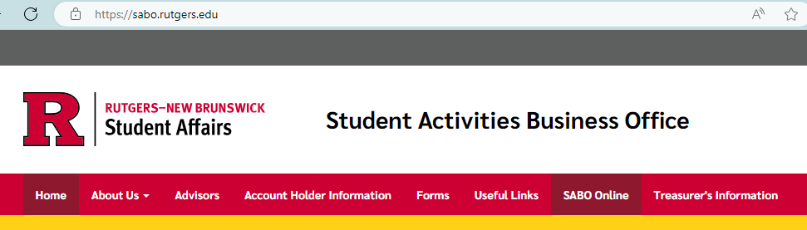
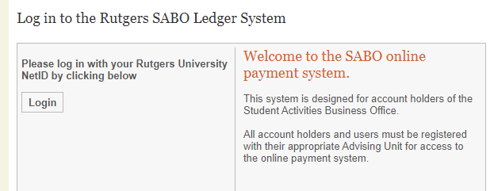
SABO Online:
To enter the SABO Online system, click the “SABO Online” link from our website.
To log in to SABO Online use your Rutgers NetID. You must be a registered user to enter the system.
Notes:
All new registered Treasurers and Presidents (Read Only) for 2026-2027 should have access to the SABO System Ledger On-line.
TEST access: sabo.rutgers.edu
If you cannot log in, Email SABO@echo.rutgers.edu. Reference your Account Name and Number.
If there was a change in officer since your initial registration, a Change of Officer form must be completed and submitted to OSI. OSI informs SABO. SABO makes the update on Fridays.

Slide 7
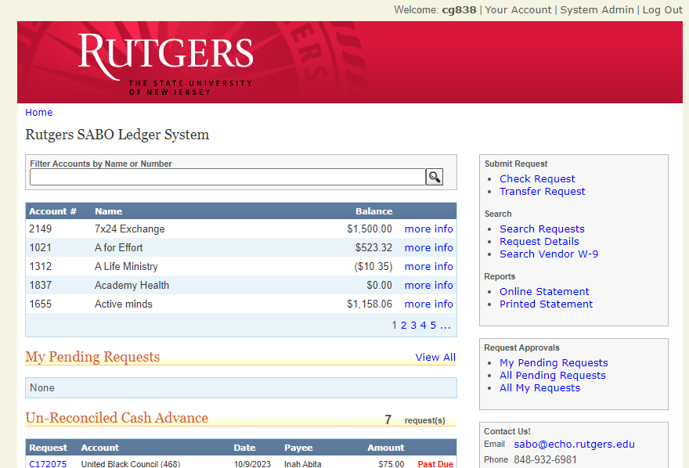
SABO Online Dashboard:
Your Dashboard displays:
  Account Balances
And has links to:
  Submit Check and Transfer Requests
  Generate your Account Statement (printed/on-line)
  Search Requests

Slide 8
Account Information:
All accounts at SABO have two Account Users. The Account Treasurer will have REGULAR access. This access will allow them to create transactions within SABO system ledger. The Account President will have READ ONLY access. This access will allow them to view transactions on-line.
All accounts at SABO have a Control Account and an Administrative Advisor assigned. The Control Account indicates which governing area oversees the account. The Administrative Advisor will be a representative who must authorize the account transactions.
Notes:
Both officers have responsibility in ensuring that their revenues (approved allocation) and expenses reflect completely and accurately.
We observed instances where a student is a Treasurer in one organization and President in another. We can only enter 1 role in the system so they will be coded as TREASURER for both.

Slide 9
Account Information:
Each SABO account has an Account Number, usually 3 or 4 digits used to differentiate your account (e.g. 1716 | Rutgers E-Sports).
Most accounts will have multiple Line Codes or sub-accounts used to isolate the source or intended use of funds (e.g. 137 Generated Revenue for account 1716, noted as 1716/137).
Most transactions will also require you to select a Transaction Code that identifies what money is being spent on. (e.g. noted as 1716/137/225 when account 1716 uses Generated Revenue (Line 137) to pay for supplies or decorations (Transaction Code 225).

Slide 10
Takebacks: (takes place in January/June)
At the end of each semester, any unspent funds in 345 are “taken back” (returned to the respective Control Account). At the end of the AY, any unspent funds in 317 are taken back.
Takebacks are used to fund appeals for the following semester.
Allocations: (takes place in August/January)
Fall 2026 Allocations received by SABO from RUSA have been processed into your respective accounts.
Allocation funds are entered in your Overhead (317) and/or Program (345) Line Codes and in some cases, Special Allocation line code (700).
Notes:
If you think your allocation amount is incorrect or has not been entered in your SABO account, please check with your Advising area or Governing Council.
If you had PENDING transactions from Spring 2026, they were not processed you may have to resubmit. Just keep in mind, funds will be coming from your Fall 2026 allocation.
You could also see some invoices that have been processed over the summer. These were invoices not entered or not approved (perhaps invoice was never sent to SABO, etc.).

Slide 11
Check Requests

Slide 12
A check request can be for:
When initiating a Check Request in SABO Online System, it is important to be able to answer the following questions:
  Who are you paying?
    Is this check to pay a person? (PERR, Contract)
      Did someone in your organization spend their own money? A PERR is a reimbursement check request to repay someone who spent personal money on approved items.
    Is this check to a Rutgers vendor or a Rutgers department?
    Is this check to pay an outside vendor (By Contract or By Invoice)
    Is this check a donation?

Slide 13
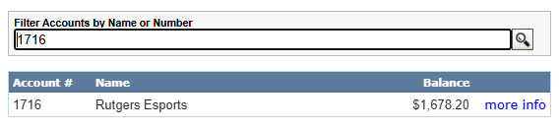

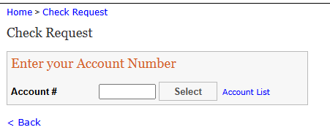
After you review the dashboard information and know your account balance you may begin to process a check request.
Click check request on the right hand side of the dashboard page and enter your account number
Notes:
When a treasurer/president logs on to SABO Online their account automatically appears. They would need to choose the account if they are on more than one account.

Slide 14
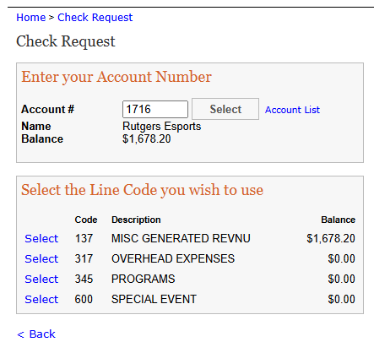
Check Request Transaction
After you have chosen the check request option on the dashboard and entered your account number and line code you will be asked:

Slide 15
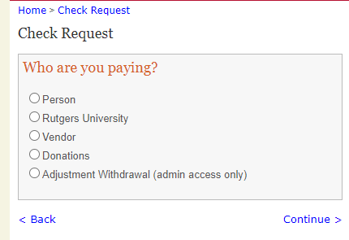
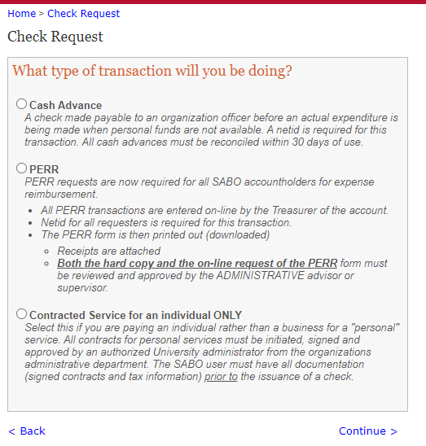
Most common Check Request is to pay a person
Cash Advance
PERR
Contracted Individual
Notes:
There are three ways a person can be paid . Cash Advance, PERR personal expense reimbursement and Contracted Individual.
There are questions for you to answer to guide you through the request process. The type of transaction to do will depend on who you are paying.

Slide 16
PERR:
All PERR forms must be submitted on-line with original, itemized receipts within 30 days of incurring the expense.
All receipts submitted for reimbursement should be marked paid or have a zero balance. Submitted reimbursements for an individual item $500 or more require proof of payment showing name and posted charge. Payment status must be “Posted” and not “Processing” or “Pending”.
Proof of Payment means a credit card or bank statement to verify the purchase. If proof of payment is under a parent/guardian name, a Consent to Reimburse Form for SABO reimbursement needs to be completed and submitted with the PERR form for processing. Payee and information on proof of payment must match.*
If a receipt is lost, a Lost Receipt Form is required. Ensure this is signed by both the person being reimbursed and Advisor.
Notes:
Supporting documentation uploaded to SABO system ledger must be complete and legible.
Show an example of Amazon receipt (Final Details for Order showing order was shipped and payment information) and proof of payment (credit card transaction) if $500 or more. Amazon billing address must match with Payee Name/Address. If not, a Consent to Reimburse Form is required.

Slide 17
Check Request for a Person (PERR)
Will show these reminders, and a checkbox indicating that they confirmed they read the reminders:
  Did you include itemized receipt?
  If using someone else’s credit card, did you include a completed Account Owner Consent Form?
  Did you include credit card statement with name of account holder and posted charge if item purchased is $500 or more?
  If receipt is lost, did you include a completed Lost Receipt Form?
  For Group Meal Expense: Did you remember to list business purpose of meal and list the names of all attendees as part of your support?

Slide 18
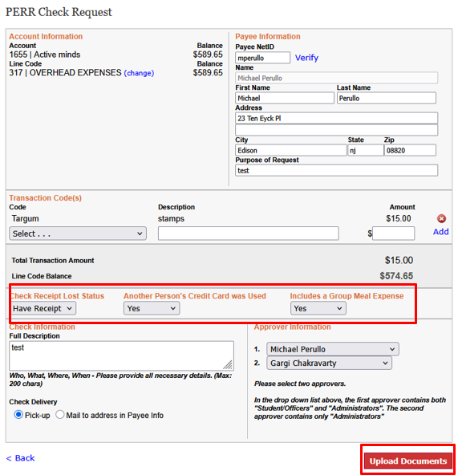
Notes:
For this change, notice the new fields ‘Check Receipt Lost Status’ (required), ‘Another Person’s Credit Card was Used’, and ‘Includes a Group Meal Expense’. Select the appropriate values from the dropdown and complete all other required fields. Click on the ‘Upload Documents’ button.
NOTE: .heic files are not uploadable!

Slide 19
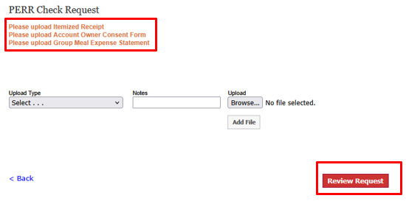
Notes:
Based upon the values selected from the dropdowns of the new fields, the following screen will let the treasurer/requester know which receipts/forms to upload. They file can be in any format.

Slide 20
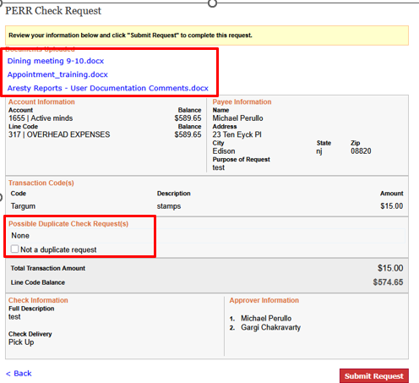
Notes:
Once all the files have been uploaded, click ‘Review Request’ to review the check request. The following screen is displayed.

Slide 21
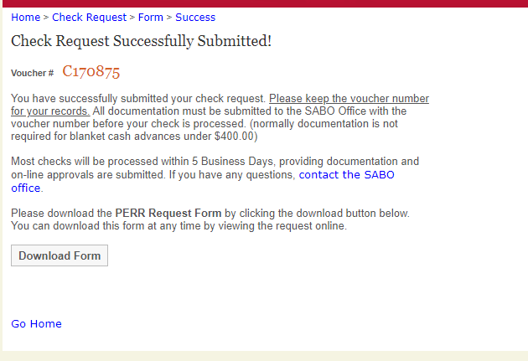
Notes:
Take note of the Voucher# or C#

Slide 22
Cash Advance:
Should be the last resort over Check Request Invoice Vendor or PERR
A Net ID is required for all Cash Advances
Used if funds are needed prior to an expenditure being made or whenever personal funds are not available
Request must be submitted at least 2 weeks before funds are needed
Minimum dollar amount of $100.
A cash advance must be supported by a budget. (Excel template available).
Dollar Limit of overage – no more than 10% of original amount
Notes:
There are 2 types of cash advances (1) related to your event (2) travel – when your org is going away on a conference, trip or event.
3 Steps: (1) Request the Advance (2) Cash and spend the funds (3) Reconcile the advance.
Cash Advance reconciliation will continue to be done in person, with original, itemized receipts.

Slide 23
Cash Advance:
The person who is the Payee in a cash advance check is the person responsible for reconciling the cash advance.
Funds withdrawn from the SABO through a Cash Advance must be reconciled within 30 days of check issue date.
Proof of payment is required for all Cash Advance expenditures.
SABO will not approve new Cash Advances* if student organization has any delinquent Cash Advance over 60 days
Only 2 cash advances can be outstanding at any given time.

Slide 24
Cash Advance Reconciliation:
After the funds have been used, original/itemized receipts and the reconciliation form must be submitted to the SABO.
Receipts submitted can’t exceed 10% of original amount.
Download Reconciliation form and present to SABO within 30 days of when the Cash Advance was issued (check date), not when it was spent.
Any delinquent Cash Advances in excess of 60 days will be grounds for suspension of all account activity.
Notes:
Any cash advance must be supported by a budget.
In the past, we’ve had students submit receipts significantly above the original amount. This is why we capped to no more than 10% of original amount. So, budgeting on the part of the student organization is important. The student has the option to submit a PERR form for expenses outside their original budget.
To illustrate: Cash Advance amount $500 x 10% = $50. You cannot submit receipts over $550. Any overage will have to be submitted with another PERR form (unless it is a single purchase).

Slide 25
Check Request for a Contracted Service (Individual)
Requires Fully Executed and Signed Contract upload
Make address line 1, city, state, zip all required fields
Will show these reminders, and a checkbox indicating that they confirmed they read the reminders:
  Did you attach the fully executed (signed by both parties) contract?
  Did you check to make sure that the Payee’s name and address on the contract matches the W-9

Slide 26
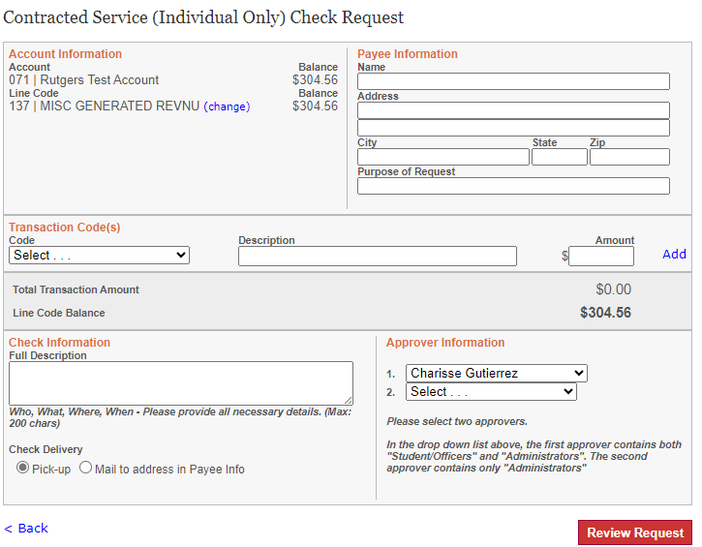
Notes:
Office of Student Involvement implemented a new contract process using DocuSign

Slide 27
Not paying a person?
There may be times your organization will not be paying a person.
The following slides include detailed instructions on how to pay :
  Rutgers University
  Vendor
  Donations

Slide 28
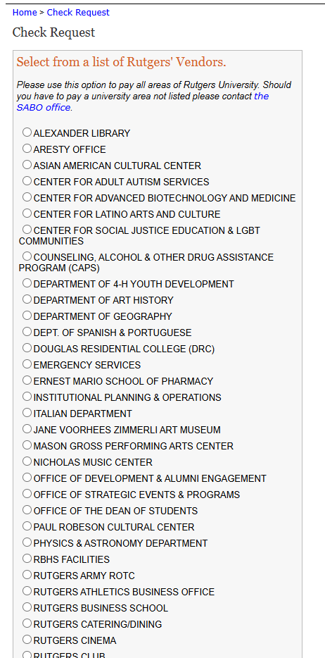
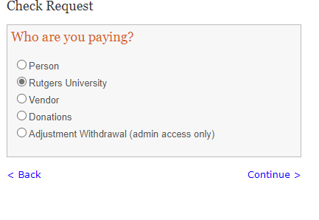
Check Request – Rutgers
Don’t see the Rutgers Dept. you need to pay OR unsure of the correct RU Dept.? Email SABO to request department to be added.
Notes:
Please use this option to pay all areas of Rutgers University. Should you have to pay a university area not listed please contact the SABO office.

Slide 29
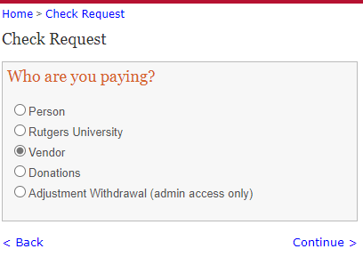
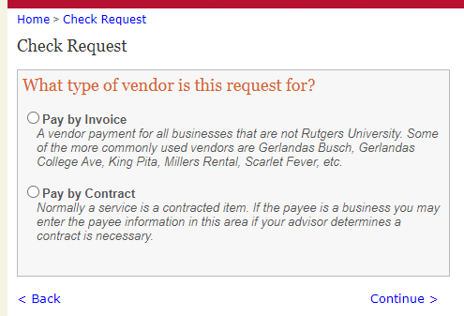
Check Request – Vendor
If there was a contract signed, Pay by Contract
If no contract was signed and you have an invoice from a vendor, Pay by Invoice.

Slide 30
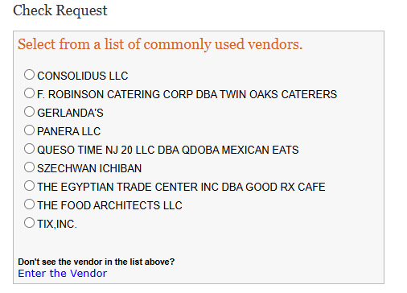
If you Pay by Invoice, SABO Online will bring up a list of on campus vendors. Review the list – if you are paying one of these vendors, select them on the left. If not, click “Enter the Vendor” at the bottom of the screen to enter the information manually.
For Specialty Caterers, please check with your Advisor to confirm that they are on the approved list before placing an order. You will need to enter their information in the Payee section. Click on the link “Enter the Vendor” to manually add them as Payee.
Notes:
We do not pay on Quotes or Estimates. Please ensure vendor has issued a final Invoice.

Slide 31
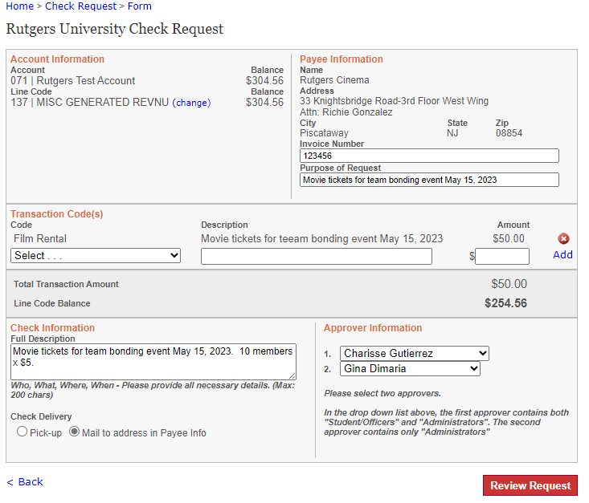
Notes:
All vendors, including Rutgers vendors, must be filled in completely. On, invoices you receive from a vendor, an invoice number must be indicated. Always put in the purpose of request. Then the transaction description which describes the expense. And finally full description. Make sure the Payee information matches information on the Invoice.

Slide 32
Invoice:
Invoice from a vendor – Treasurer must submit a Check Request in the system Check Request -> Vendor -> Pay by Invoice.
Treasurer will upload required documentation in SABO System, including W-9 if available.
Remind vendor to E-mail W-9 to SABO@echo.rutgers.edu with the “C” number in the subject line
Not approvable if support is a Quote and not an Invoice (Exception: Panera Catering/Consolidus)
Notes:
**please ensure the vendor address matches the invoice. If Remit to address is different, indicate this in the Description field.

Slide 33
Contracts:
Treasurer is responsible for initiating the contract process on Suitable (new platform).
Step by step instructions are found here:
Contract Process | Student Centers and Activities - Division of Student Affairs | Rutgers University-New Brunswick
Requires Fully Executed and Signed Contract and Payee W-9 uploaded in SABO System
Remind Payee to E-mail W-9 to SABO@echo.rutgers.edu with the “C” number in the subject line if it is not uploaded in SABO directly

Slide 34
Donation:
Student organizations may make donations from their Misc. Generated Revenue line code (137) only.
All donations must be made to an approved charity that has 501©(3) status recognized by the IRS.
Address needs to match the charity.
The charity must be in the United States
No documentation is needed* as long as there is a Tax ID # and is found on the IRS website
SABO will approve when it is a verified 501©(3)
SABO will mail check requesting a receipt/acknowledgment for the donation
Notes:
*in some instances, we may request a W-9. There may be multiple charitable organizations with the same name on the IRS website.

Slide 35
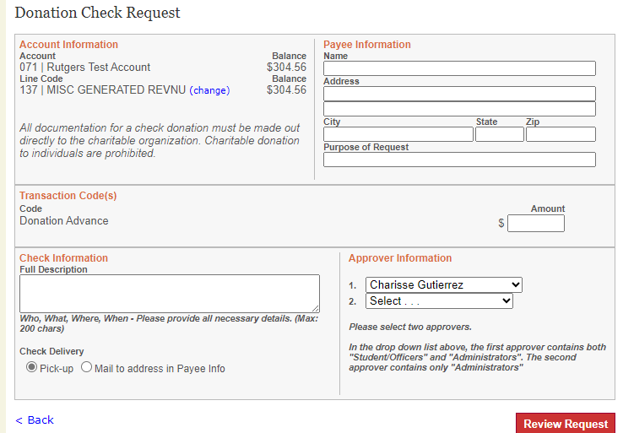
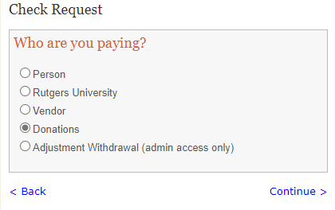

Slide 36
Transfer:
Select Transfer Request from the Dashboard
Enter “From” account and select the Line Code
Enter “To” account and select the Line Code
Choose Transaction Codes and provide a full description for the Transfer, Enter Amount, Select Approver
Review the request, submit if correct, and write down the Transfer number#.
If a co-sponsorship, Co-Sponsorship Agreement must be submitted to SABO.
Notes:
You cannot transfer funds from O/H, Programs, Special Allocation to Misc. G/R but can do so the other way around.
Co-sponsorship Agreement – can be found on Suitable (new student engagement platform)
If a co-sponsorship, Co-Sponsorship Agreement must uploaded in SABO System.
The form can be found on Suitable.
Co-sponsorship funds should not be transferred to line code 137 (Generated Revenue)

Slide 37
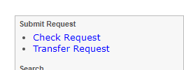
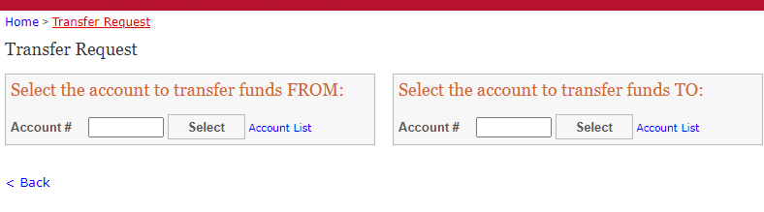
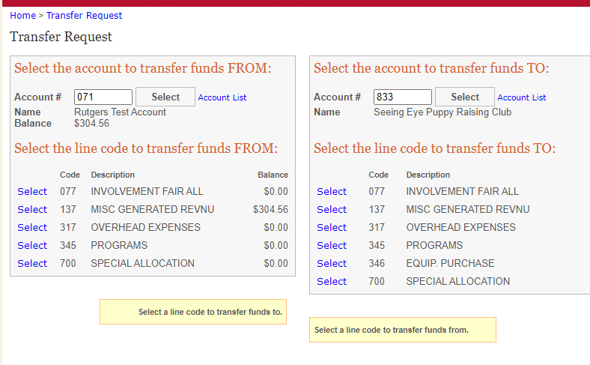

Slide 38
Transfer:
You cannot transfer funds from O/H, Programs, Special Allocation to Misc. G/R but can do so the other way around.
Transfer between O/H and Programs must be approved by RUSA Allocations.
Please select “RUSA Chair” under dropdown menu for Approver 2
Notes:
You cannot transfer funds from O/H, Programs, Special Allocation to Misc. G/R but can do so the other way around.
Co-sponsorship Agreement – can be found on Suitable (new student engagement platform)
If a co-sponsorship, Co-Sponsorship Agreement must uploaded in SABO System.
The form can be found on Suitable.
Co-sponsorship funds should not be transferred to line code 137 (Generated Revenue)

Slide 39
Request Review Procedures:
All check requests (and transfers) are done online.
All check requests require* a mailing address, even if marked for ‘Pick-Up’.
Ensure Transaction Code* selected is appropriate.
Advisor reviews uploaded documentation and approves on-line.
We highly recommend supporting documentation (e.g. original, itemized receipts) be maintained by Treasurer in the event of an audit.
Notes:
*This is a required field in the system. Mailing address is particularly important because of ESCHEAT regulations.
Transaction Code ex. “Equipment vs. Supplies”

Slide 40
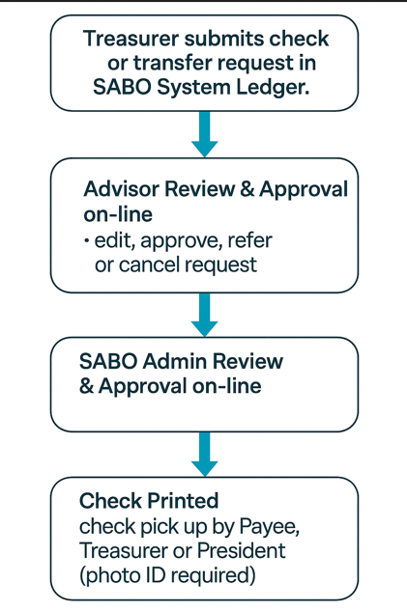
Submission Flow Chart

Slide 41
Depositing into your SABO Account:
A Deposit Slip must be completed for the funds to be properly credited to your SABO Account.
Include on each check: Account number, Line Code, and Transaction Code (e.g. “123 | 137 | 061”)
All checks must be made out to “Rutgers University”.
You will receive a receipt after the deposit is made.
All funds deposited will be credited to your account after 5pm.
Any returned checks will be debited (subtracted) from your account. It is the responsibility of the Treasurer to pursue collection.
Checks that are DONATIONS cannot be deposited directly to your SABO account. Please see Business Manager who will route it to RU Foundation for processing.
Notes:
Donation receipts must flow through the RU Foundation. It will ultimately get deposited to your SABO account.
Deposits made at the Student Centers (CAC, Busch, Livi).

Slide 42
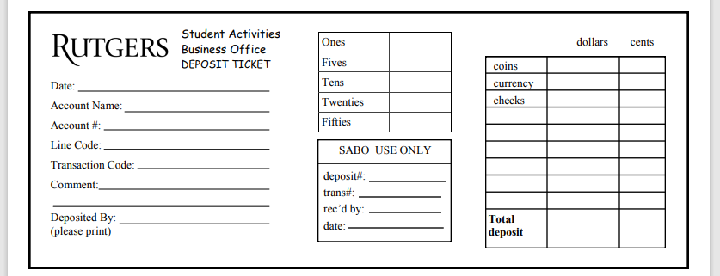
Deposit Slip:

Slide 43
Check Request Status in SABO System Ledger:
Pending – waiting on your Advisor to approve
Submitted to SABO for Approval – if it has been more than a week, please contact SABO. This may mean supporting documentation is not sufficient for processing.
Approved – supporting documentation was reviewed and request is approved for payment.
Check Cut – check is printed, mailed or check is available for pick up (within 3 days of the check date)
**please inform Payees to pick up check at SABO promptly**

Slide 44
Stop Payment Request Form
ACKNOWLEDGEMENT & FEE NOTICE:
By signing below, I am requesting a stop payment on the check listed above. I understand that a non-refundable $15 service fee will be charged to whomever was responsible in losing the check. The stop payment will be processed within 2-3 business days after this completed form is received. I acknowledge that the original check will be voided and cannot be deposited once this request has been submitted.

Slide 45
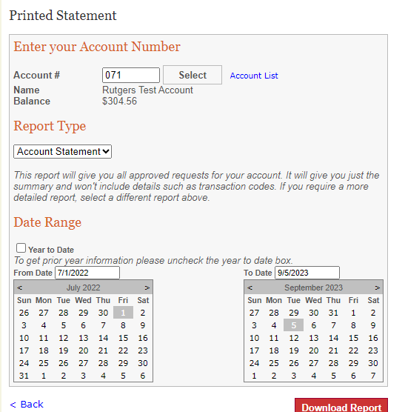
IMPORTANT - Review your Account Statement Regularly!
Click on “Statements” from the Dashboard
Enter the Account Number and select either “Account Statement” or “Request Details”.
Keep the “Year to Date” box checked or unclick it to choose a specific date range.
Click “Download Report” to generate a .pdf of your specified statement.
Note: Statements do not reflect pending transactions. Statements reflect only transactions that have been posted to the account.
Notes:
Review for COMPLETENESS: Make sure all your revenues (income) and expenses are reflected in your account. If missing, follow up!
Review for ACCURACY: Do you have pending transactions that have not been approved?
Deposits made at Student Centers
Keep your receipt
Follow up timely

Slide 46
Special Topics

Slide 47
CONSOLIDUS:
Rutgers Primary Licensee for Branded Merchandise is CONSOLIDUS https://www.swagbyconsolidus.com/
It’s the one-stop shop for all promotional and swag/giveaway needs.
All students can log in and browse using their Net ID.
Presidents and Treasurers have the authorization to place order. (discuss with Advisor prior to placing order)
All orders will be paid by invoice directly to Consolidus and will require the Treasurer to submit a check request to SABO.

Slide 48
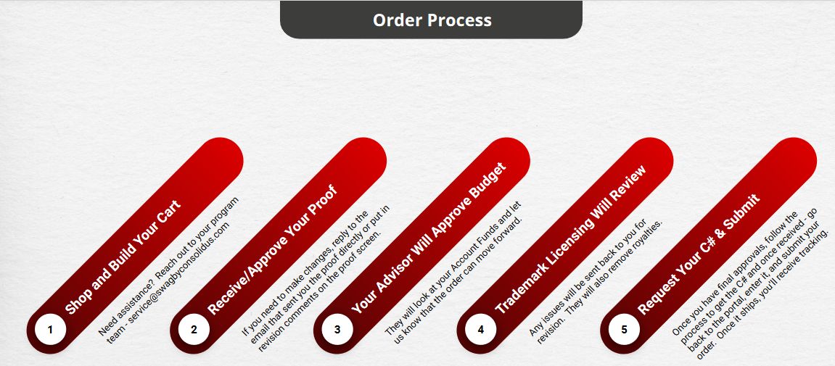
CONSOLIDUS WORKFLOW:
Notes:
Getting Started -> Quick Start Guide on swag.rutgers.edu
Can’t modify RU marking
Must use full org name
Need to be clear on “firm date”.
If ordering custom stoles – start the process in March in time for graduation.

Slide 49
TRAVEL:
No home sharing (AirB&B, VRBO, etc.)
Conference Travel – student orgs must plan ahead so that we can pay hotel vendor via check instead of cash advance.
Required documents:
  Booking confirmation
  Proof of payment with a bank statement verifying the purchase
  Hotel folio at check-out

Slide 50
Non-Reimbursable Expenses:
Although not a complete list, this list offers examples of expenses that will not be reimbursed by Rutgers University – Student Activities Business Office (SABO)
Fees incurred for changing reservations e.g. late check out fee, room upgrade, etc. (unless there is a business justification)
Unreasonably expensive meals, lodging. Gratuity is limited to 20%.
Any goods or services for student organizations purchased OUTSIDE* of the United States (including contracting with an international vendor).
Purchases made using a gift card, account credits or using personal airline miles is not reimbursable.
Branded merchandise, swag, promotional items not purchased through Consolidus.
Notes:
*Must have a U.S. presence. Company like Temu (office address in MA), Alibaba (warehouses in LA, NY, SF)
Unreasonably expensive meals will be capped. Gratuity for sit-down meals is limited to no more than 20% of meal total.

Slide 51
Mileage Reimbursement
Mileage reimbursement covers the wear and tear of operating a personal vehicle for business reasons.
For 2026, the IRS mileage reimbursement rate is .76 cents per mile driven for business use.
Business justification
Google Maps / round-trip
Normal commute must be deducted or not included.
Notes:
*mileage or gas receipt, cannot be both. IRS mileage rate for reimbursement is up 2.5 cents from last year.

Slide 52
Meal Limits/Group Meals:
Current meal reimbursement per person per day inclusive of tax and gratuity*.
  $20 in-state
  $30 out-of-state travel
Business Purpose of the Meal has to be stated
For Group Meals (sit-down meals): List Names of all attendees on a Word document and upload this in the check request.
Notes:
Unreasonably expensive meals will be capped. Gratuity for sit-down meals is limited to no more than 20% of meal total.
Advisor may change reimbursement amounts if request exceeds per day meal limit.
For now, these are the reimbursement limits.
**not the signature page of the receipt. Detail required.

Slide 53
Prize, Award and Gift Cards
Did they include the name of recipients for prizes under $100.
Did they submit the Prize and Gift Form for prizes $100 or more, including SSN*?
All prize, gift cards must be purchased through generated revenue line code 137.
Purchases made using a gift card, account credits (e.g. Amazon) is not reimbursable.
Notes:
E-Sports – gaming competitions where they invite non-RU students – we need their W-9 in addition to the prize form.
In-kind (gift basket), if worth $100 or more, need prize form completed.

Slide 54
Specialty Catering/Panera (Customer ID 1550018)
PANERA Catering Procedures
Student org contact John Somerville at least 3-4 days in advance at (636) 280-5857 or Email: john.somerville@panerabread.com to place catering order. Student Org must inform John of their SABO Name and Account #
John or Designee will send student org an Order Confirmation.
Treasurer creates a check request in SABO using the Order Confirmation: Vendor -> Pay by Invoice. Use the Order Confirmation Number in Invoice number field and date of delivery in description. Treasurer must upload the Order Confirmation within their check request in SABO System.
After catering has been delivered, Panera will send final invoice to SABO. SABO will upload the final invoice once in SABO’s queue to review and approve on-line. SABO Admin will update the order confirmation number with the final invoice number.
Notes:
Under Vendors, we removed the “commonly used” specialty vendors on the list. Treasurers now must manually add the vendor as Payee. Advisors will check that they are on the approved list before approving.
Gerlanda’s, Szechuan Ichiban – PAY BY INVOICE, NOT OUT-OF-POCKET - let them know that you are a student organization (provide account name and number). They will send student org an invoice. Treasurer will need to create a check request and upload invoice in SABO system.
Specialty Catering for ethnic food vendors – OSI has a list updated monthly and distributed by Susan Romano, Associate Director. Check with your Administrative Advisor before ordering.

Slide 55
Tip Policy for Student Organizations
Tips are not allowed for any orders from on-campus or off-campus caterers for events or meetings. If any tips are given, the student who approved the tip will be responsible for payment, or it will be taken out of the organization's generated revenue line if funds are available.
Up to a 20% tip can be applied to a restaurant order when a student/group of students attends a trip/conference/competition with a student organization. Any tips exceeding the 20% will be the responsibility of the student that approved it or it will be taken out of the organization's generated revenue line if funds are available.
Note: Treasurers need to share this information with their members and decide in advance of finalizing any orders whether they want any tips to come out of GR when submitting food orders or PERR check requests. If taking out of GR, they must transfer funds to the line of the check request and make note of what this transfer is for.
Friendly reminder that all caterers must deliver.
Notes:
Under Vendors, we removed the “commonly used” specialty vendors on the list. Treasurers now must manually add the vendor as Payee. Advisors will check that they are on the approved list before approving.
Gerlanda’s, Szechuan Ichiban – PAY BY INVOICE, NOT OUT-OF-POCKET - let them know that you are a student organization (provide account name and number). They will send student org an invoice. Treasurer will need to create a check request and upload invoice in SABO system.
Specialty Catering for ethnic food vendors – OSI has a list updated monthly and distributed by Susan Romano, Associate Director. Check with your Administrative Advisor before ordering.

Slide 56
Other Items:
TIX.COM
Ticket Sale set up via Suitable.
There are no refunds or exchanges.
Ticket sale revenue is booked monthly by SABO in the student org’s account
STUDENT CENTER MEETING SPACE AND RESERVATIONS INVOICING
Final invoices are sent to OSI.
OSI student worker enters the invoices and routes to Advisor for approval.
No need to send invoice with C# to SABO Email
END OF SEMESTER GIFTS
Student Organizations are prohibited from submitting reimbursement requests for gift expense to faculty and staff/advisors using SABO funds. This includes funds from Line Code 137/Misc. Generated Revenue.

Slide 57
UPDATES:
Encumbrance of Funds implemented
Cash Advance minimum amount is $100.00
Approver 2: Advisor
Transfer Requests between O/H and Programs Approver 2: “RUSA Alloc Chair”
Replies in “Send Notes” within SABO System not in E-mail
Notes:
SABO System Encumber Funds
Previous State: Funds are only deducted from student organization account line code balance after SABO has approved for payment. (Approved status)
Future State: Funds will be deducted from student organization account line code balance after Treasurer submits the check request in the SABO Ledger System (Pending status)
Prevents student organizations from overspending
Provides real-time snapshot of available funds vs. committed funds

Slide 58
Treasurer Responsibilities:
Plan, inform, ask before spending
Be organized, keep original receipts for audit
Communicate policies and procedures with fellow E-Board Members. Share information on ListServ.
Be timely when submitting expenses for reimbursement
Utilize SABO Administrative Advisor as your main point of contact
Familiarize yourselves with the various resources available
Notes:
Communication with your Advisor is KEY

Slide 59
RESOURCES:
Training/Quiz on CANVAS
sabo.rutgers.edu / Treasurer Information
  Treasurer’s Key (handbook) – revised August 2026
  Tip Sheets – revised August 2026
  Consolidus Workflow for the swag portal (swag.Rutgers.edu)
Forms
  Account Owner Consent to Reimburse Form
  Deposit Slip
  IRS W-9 (blank)
  Lost Receipt Certification
  Prize, Award and Gift Card Information
  Stop Payment
Notes:
After review of the Treasurer’s Key, PowerPoint on Treasurer Refresher Training, Tip Sheets, Treasurers are required to take the mandatory quiz. They will be given (3) tries and must score 80% or higher to pass. 35 questions (need 28 correct answers to pass).
Returning Treasurers who have taken the quiz in the past must re-take the quiz.

Slide 60
How to Access SABO Services?
In-person
  Student Activities Center (SAC) – College Ave Campus
  613 George St (Lower Level)
  SABO Window Hours*: Monday-Friday 9am-4:30pm
  Main Office: 848-932-6981
2. On-line (SABO System Ledger)
  sabo.rutgers.edu
3. Email - Reference SABO Account Name and Number, including the voucher C# in the subject line of E-mail.
  sabo@echo.rutgers.edu
Notes:
SABO normal operating hours 8:30 – 5pm, M-F.

Slide 61
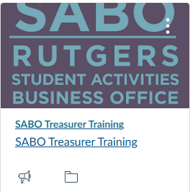
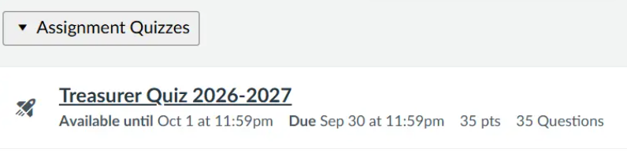
  Canvas – Treasurer Training
Notes:
After review of the Treasurer’s Key Handbook, Treasurer Training PowerPoint and Tip Sheets please take the mandatory quiz. You will be given three (3) tries and must have a score of 80 or higher to pass, which is equivalent to a score of 28 points out of 35.
Returning Treasurers who have taken the quiz in the past must re-take the quiz every year.

Slide 62
Weekly SABO Drop-In Office Hour via Zoom (or in person) beginning September 1.
Tuesdays, 1:30 to 2:30 PM
Wednesdays, 11:30 to 12:30 PM
Log in to your Rutgers Zoom Account
Meeting ID: 538 538 3149
Password: 630856

Slide 63
Q&A
Thank you!

