Slide 1
Student Activities Business Office (SABO)
NEW TREASURER TRAINING
September 3 and 4, 2024

Slide 2
Today’s Session:
Understanding SABO’s core responsibilities
SABO staff & areas of responsibilities
Account and Control Account information
Allocation and Takebacks
SABO System Ledger Navigation
Special Topics
Updates
Treasurer Responsibilities and Resources
Q&A / Discussion

Slide 3
Understanding SABO’s Core Responsibilities:
We administer and manage the financial resources of the undergraduate student organizations.
We ensure compliance with all University policies and procedures in relation to the use of student and University funds.
We provide the administrative infrastructure (ledger system) for Treasurer/President and Advisor to account for the financial transactions of their organization.
Notes:
University Student Funds: comprised of student fees, generated revenue, dues and allocated funds.
SABO’s core function is accounts payable (A/P) and student expense reimbursements. Faculty and staff cannot be reimbursed from SABO student org account.
We do not do advising. Instead, we partner with OSI Administrative Advisors (different from Faculty Advisor). Your Advisor must be you first point of contact!
The goal of compliance is to help protect the University against risk associated with the use of these funds. Avoiding Risk of Asset Misappropriation

Slide 4
SABO Staff & Areas of Responsibilities:
Charisse Gutierrez – Director/Business Manager
Geraldine Howard – Accounting Assistant I
non-RU Invoices, Contracts, Transfers, Allocations/Takebacks
Jill Silverman – Accounting Assistant II
PERR, System Access, Canvas, List Serv
Gina DiMaria – Head Accounting Clerk
RU invoices, Cash Advances, Donations
Federal Student Workers
Notes:
RU Invoices: Dining/Catering, Facilities, Meeting Space and Reservations
FWS: will be at the window / answering phones
SABO Email (sabo@echo.rutgers.edu) is monitored by professional staff during normal working hours (no nights/no weekends).

Slide 7
SABO Location and Hours:
We are located on the lower level of the Student Activities Center (SAC) on the College Ave. Campus, 613 George St.
During fall and spring semesters, we are open Monday-Friday from 8:30 am to 5:00 pm
Window Hours Monday-Friday from 9 am to 4:30 pm
Notes:
If you Email us after 5pm or on the weekend, we will not respond until the next business day.

Slide 8
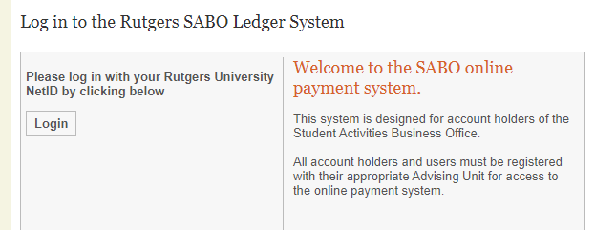
SABO Online:
To enter the SABO Online system, click the “SABO Online” link from our website.
To log in to SABO Online use your Rutgers NetID. You must be a registered user to enter the system.
Notes:
At this time, all new registered Treasurers and Presidents (Read Only) for 2024-2025 should have access to the SABO System Ledger On-line. New and returning Treasurers (RUSA, RBGA, SEBS funded orgs only).
TEST access: sabo.rutgers.edu
If you cannot log in, Email SABO@echo.rutgers.edu. Reference your Account Name and Number.
If there was a change in officer since your initial registration, a Change of Officer form must be completed and submitted to OSI. OSI informs SABO. SABO makes the update.

Slide 9
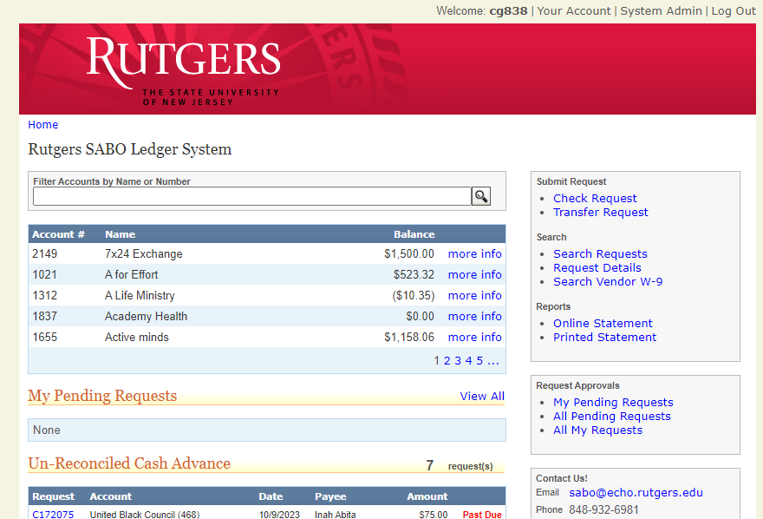
SABO Online Dashboard:
Your Dashboard displays:
Account Balances
And has links to:
Start a Check request
Start a Transfer
Generate your Account Statement
Search Requests

Slide 10
Account Information:
Each SABO account has an Account Number, usually 3 or 4 digits used to differentiate your account (e.g. 063 | Bengali Student Association).
Most accounts will have multiple Line Codes or subaccounts used to isolate the source or intended use of funds (e.g. 137 Generated Revenue for account 063, noted as 063/137).
Most transactions will also require you to select a Transaction Code that identifies what money is being spent on. (e.g. noted as 063/137/225 when account 063 uses Generated Revenue (Line 137) to pay for supplies or decorations (Transaction Code 225).

Slide 11
Account Information:
All accounts at SABO have two Account Users. The Account Treasurer will have REGULAR access. This access will allow them to create transactions within SABO system ledger. The Account President will have READ ONLY access. This access will allow them to view transactions on-line.
All accounts at SABO have a Control Account and an Administrative Advisor assigned. The Control Account indicates which governing area oversees the account. The Administrative Advisor will be a representative who must authorize the account transactions.
Notes:
Both officers have responsibility in ensuring that their revenues (approved allocation) and expenses reflect completely and accurately.
We observed instances where a student is a Treasurer in one organization and President in another. We can only enter 1 role in the system so they will be coded as TREASURER for both.

Slide 12
Allocations and Takebacks:
All FALL Allocations received by SABO from RUSA, SEBS and RBGA have been processed into your respective accounts.
Allocation funds are entered in your Overhead (317) and/or Program (345) Line Codes and in some cases, Special Allocation line code (700).
At the end of each semester, any unspent funds in 345 are “taken back” (returned to the respective Control Account). At the end of the AY, any unspent funds in 317 are taken back.
Takebacks are used to fund appeals for the following semester.
It is important that expenses are submitted within 30 days of incurring the expenses and that transactions posted in your account are reviewed for completeness and accuracy.
Notes:
If you think your allocation amount is incorrect or has not been entered in your SABO account, please check with your Advising area or Governing Council.
If you had PENDING transactions from SP24, they were not processed and were most likely cancelled with a comment “Did not receive supporting documentation to process.”

Slide 13
Check Requests

Slide 14
A check request can be for:
When initiating a Check Request in SABO Online System, it is important to be able to answer the following questions:
Who are you paying?
Is this check to pay a person? (PERR, Contract)
Did someone in your organization spend their own money? A PERR is a reimbursement check request to repay someone who spent personal money on approved items.
Is this check to a Rutgers vendor or a Rutgers department?
Is this check to pay an outside vendor (By Contract or By Invoice)
Is this check a donation?

Slide 15
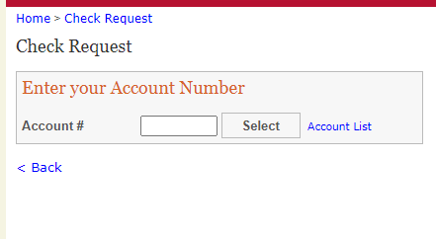
After you review the dashboard information and know your account balance you may begin to process a check request.
Click check request on the right hand side of the dashboard page and enter your account number

Slide 16
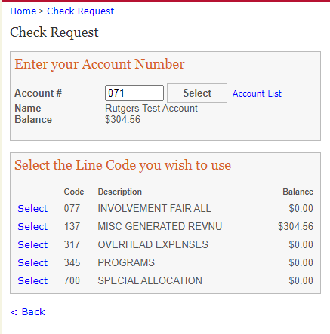
Check Request Transaction
After you have chosen the check request option on the dashboard and entered your account number and line code you will be asked:

Slide 17
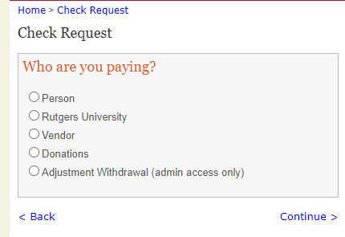
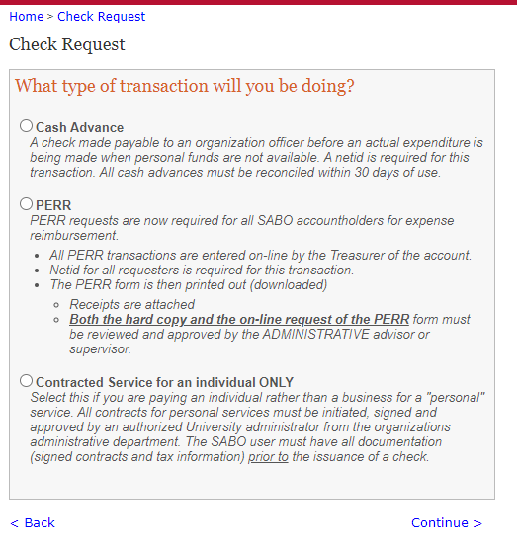
Most common Check Request is to pay a person
Cash Advance
PERR
Contracted Individual
Notes:
There are three ways a person can be paid . Cash Advance, PERR personal expense reimbursement and Contracted Individual.
There are questions for you to answer to guide you through the request process. The type of transaction to do will depend on who you are paying.

Slide 18
Cash Advance:
Should be the last resort over Check Request Invoice Vendor or PERR
A NET ID is required for all Cash Advances
Used if funds are needed prior to an expenditure being made or whenever personal funds are not available
Request must be submitted at least 2 weeks before funds are needed
A cash advance must be supported by a budget. (Excel template available).
Notes:
There are 2 types of cash advances (1) related to your event (2) Travel – when your org is going away on a conference, trip or event.
3 Steps: (1) Request the Advance (2) Cash and spend the funds (3) Reconcile the advance.

Slide 19
Cash Advance:
The person who is the Payee in a cash advance check is the person responsible for reconciling the cash advance.
Funds withdrawn from the SABO through a Cash Advance must be reconciled within 30 days of check issue date.
Proof of payment is required for all Cash Advance expenditures.
SABO will not approve new Cash Advances* if student organization has any delinquent Cash Advance over 60 days
Only 2 cash advances can be outstanding at any given time.
Notes:
*or any other expense reimbursement request.

Slide 20
Cash Advance Reconciliation:
After the funds have been used, original/itemized receipts and the reconciliation form must be submitted to the SABO.
Receipts submitted can’t exceed 10% of original amount.
Download your Reconciliation form and present to SABO within 30 days of when the Cash Advance was issued (check date), not when it was spent.
Any delinquent Cash Advances in excess of 60 days will be grounds for suspension of all account activity.
Notes:
Any cash advance must be supported by a budget.
In the past, we’ve had students submit receipts significantly above the original amount. This is why we capped to no more than 10% of original amount. So budgeting on the part of the student organization is important. The student has the option to submit a PERR form for expenses outside their original budget.
To illustrate: Cash Advance amount $500 x 10% = $50. You cannot submit receipts over $550.

Slide 21
PERR:
All PERR forms must be submitted with original, itemized receipts (no pictures, no copies), within 30 days of incurring the expense. Treasurers must submit to Advisor, Advisor reviews/signs-off and submits to SABO or given back to Treasurer to submit.
All receipts submitted for reimbursement should be marked paid or have a zero balance. Submitted reimbursements for an individual item over $500 require proof of payment showing name and posted charge. Payment status must be “Posted” and not “Processing”.
Proof of Payment means a credit card or bank statement to verify the purchase. If proof of payment is under a parent/guardian name, a Consent to Reimburse Form for SABO reimbursement needs to be completed and submitted with the PERR form for processing. Payee and information on proof of payment must match.*
If a receipt is lost, a Lost Receipt Form is required. Ensure this is signed by both the person being reimbursed and Advisor.
Notes:
PERR Personal Expense Reimbursement Report.
Show an example of Amazon receipt and proof of payment (credit card transaction). Amazon billing address must match with Payee Name/Address.

Slide 22
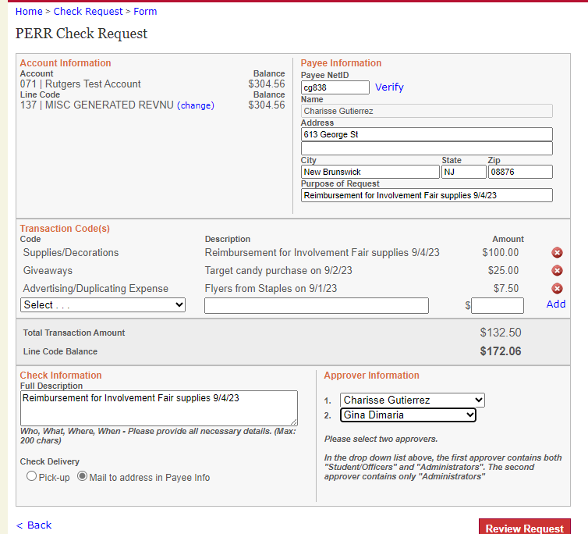
Notes:
PERR form review. Once reviewed hit submit.

Slide 23
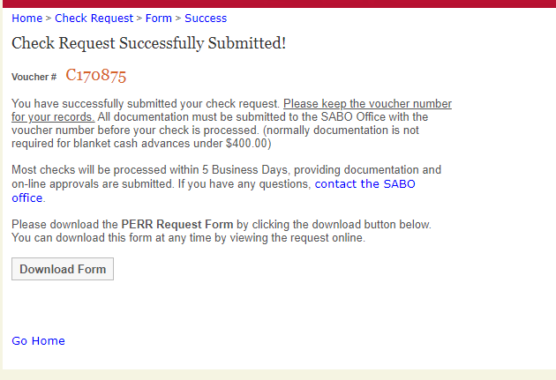
Notes:
Take note of the Voucher# or C#

Slide 24
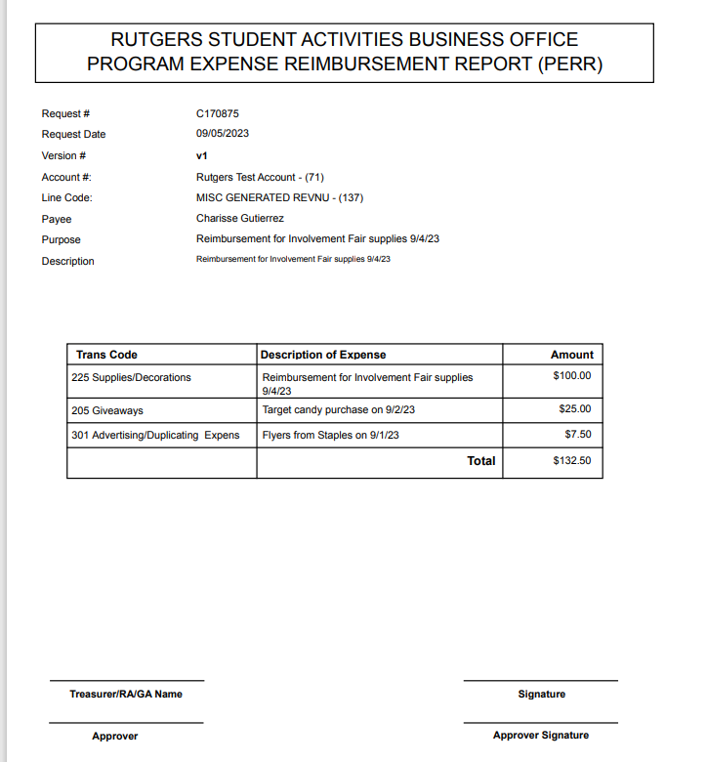
Notes:
Hard copy PERR must be signed by both Treasurer and Advisor. Attached original, itemized receipts.

Slide 25
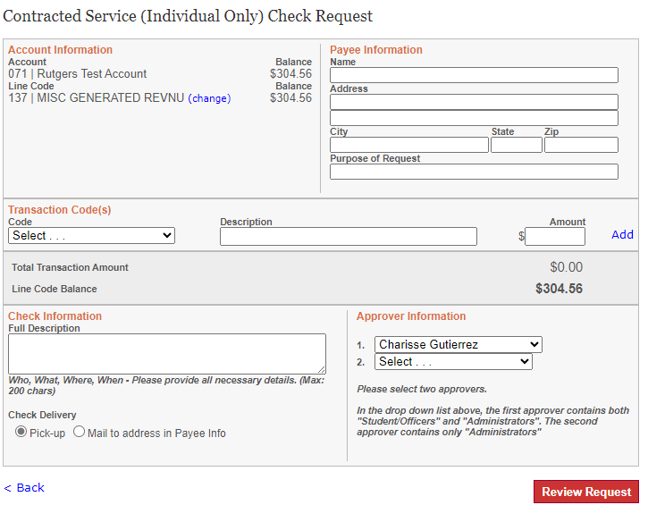
Notes:
Office of Student Involvement implementing a new contract process using DocuSign

Slide 26
Not paying a person?
There may be times your organization will not be paying a person.
The following slides include detailed instructions on how to pay :
Rutgers University
Vendor
Donations

Slide 27
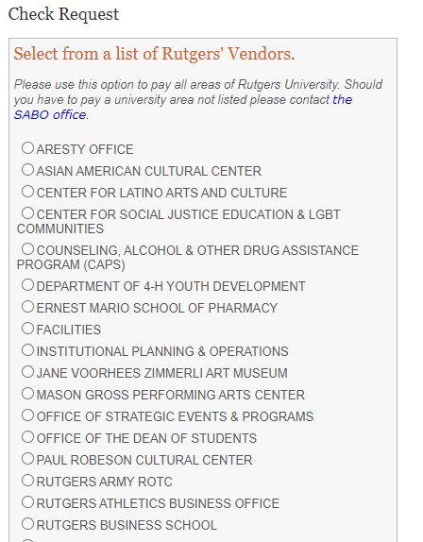
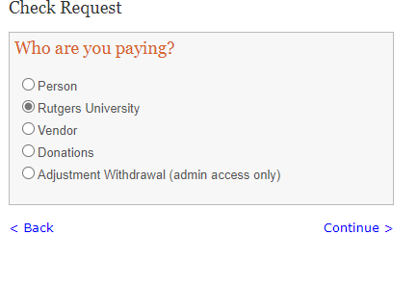
Check Request – Rutgers
Don’t see the Rutgers Dept. you need to pay OR unsure of the correct RU Dept.? Email us and we can add them or clarify!
Notes:
Please use this option to pay all areas of Rutgers University. Should you have to pay a university area not listed please contact the SABO office.

Slide 28
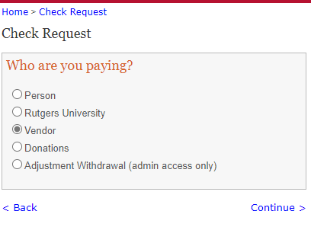
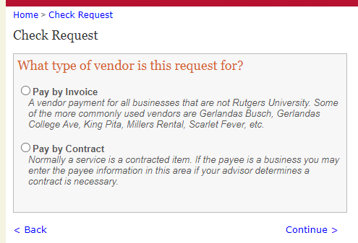
Check Request – Vendor
If there was a contract signed, Pay by Contract
If no contract was signed and you have an invoice from a vendor, Pay by Invoice.

Slide 29
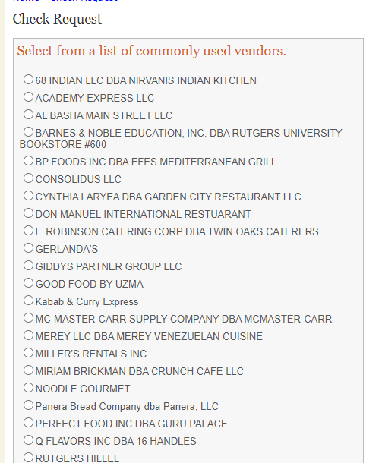
If you Pay by Invoice, SABO Online will bring up a list of Commonly Used Vendors. Review the list – if you are paying one of these vendors, select them on the left. If not, click “Enter the Vendor” at the bottom of the screen to enter the information manually.
Notes:
We do not pay on Quotes or Estimates. Please ensure vendor has issued a final Invoice.
Our list of commonly Used Vendors does not mean that they are an approved vendor for you to use. Example: Krispy Pizza

Slide 30
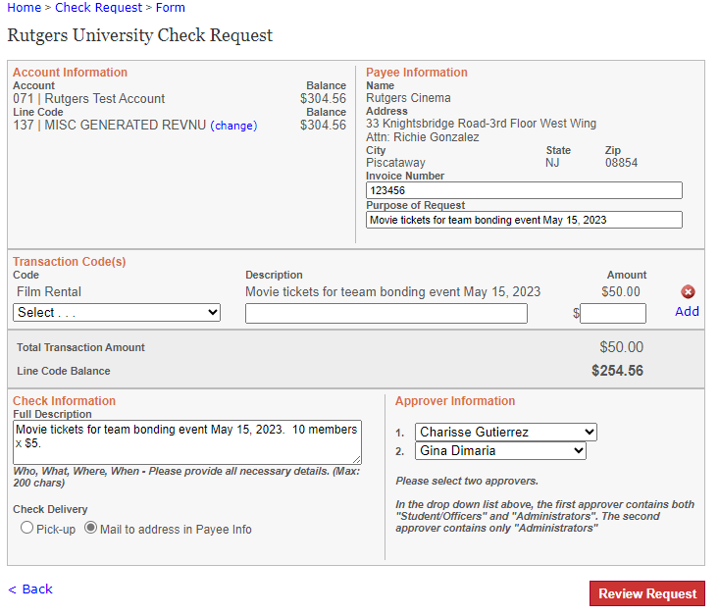
Notes:
All vendors, including Rutgers vendors, must be filled in completely. Also on invoices you receive from a vendor, an invoice number must be indicated. Always put in the purpose of request. Then the transaction description which describes the expense. And finally full description. Make sure the Payee information matches information on the Invoice.

Slide 31
Invoice:
Invoice from a vendor – Treasurer must submit a Check Request in the system Check Request -> Vendor -> Pay by Invoice.
Treasurer must E-mail /submit the invoice and W-9 to SABO@echo.rutgers.edu with the “C” number in the subject line and cc: Advisor
Not approvable if support is a Quote and not an Invoice (Exception: Panera Catering/Consolidus)
Notes:
RU Vendor List; non-RU Vendor List
**when selecting RU vendor, please ensure the address matches your invoice.

Slide 32
Donation:
Student organizations may make donations from their Misc. Generated Revenue line code (137) only.
All donations must be made to an approved charity that has 501©(3) status recognized by the IRS.
Address needs to match the charity.
The charity must be in the United States
No documentation is needed* as long as there is a Tax ID # and is found on the IRS website
SABO will approve when it is a verified 501©(3)
SABO will mail check requesting a receipt/acknowledgment for the donation
Notes:
*in some instances, we may request a W-9. There may be multiple charitable organizations with the same name on the IRS website.

Slide 33
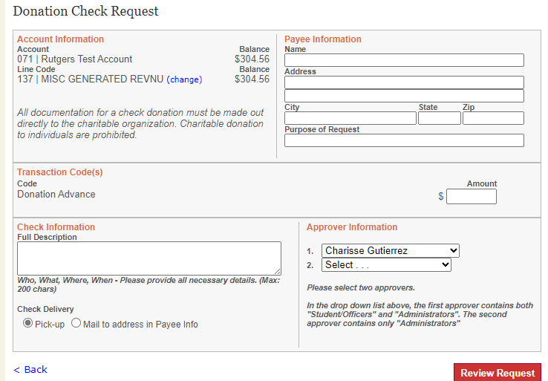
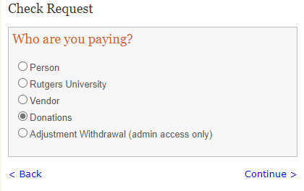

Slide 34
Transfer:
Select Transfer Request from the Dashboard
Enter “From” account and select the Line Code
Enter “To” account and select the Line Code
Choose Transaction Codes and provide a full description for the Transfer, Enter Amount, Select Approver
Review the request, submit if correct, and write down the Transfer number#.
If a co-sponsorship, Co-Sponsorship Agreement must be submitted to SABO.
Notes:
You cannot transfer funds from O/H, Programs, Special Allocation to Misc. G/R but can do so the other way around.
Co-sponsorship Agreement – can be found on getINVOLVED.

Slide 35
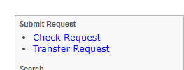
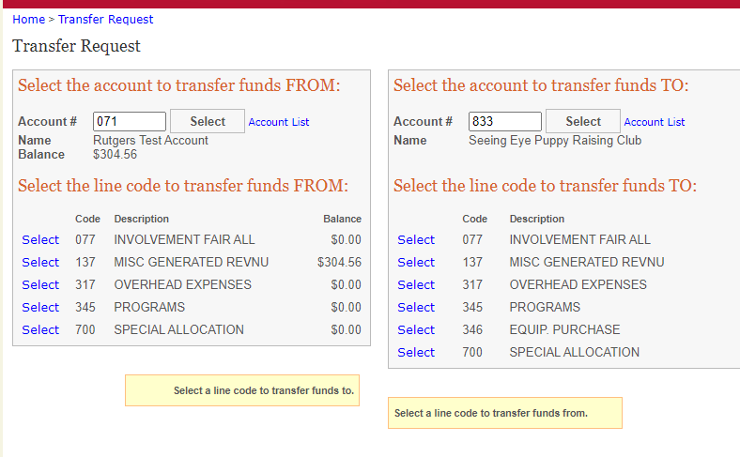

Slide 36
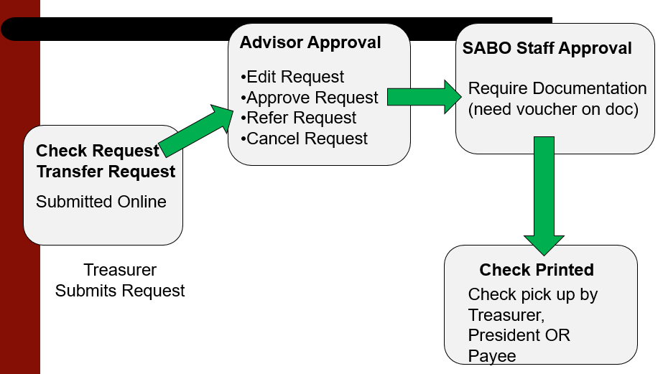
Submission Flow Chart

Slide 37
Check Request Status in SABO System Ledger:
Pending* – waiting on your Advisor to approve
Submitted to SABO for Approval* – if it has been more than a week, please contact SABO. This may mean we have not received supporting documentation to complete processing
Approved* – supporting documentation was reviewed and request is approved for payment. Sometimes, we may approve pending additional information requested (e.g. credit card statement showing charges posted)
Check Cut – check is printed and will be mailed or check is available for pick up (within 3 days of the check date) **please pick up check at SABO promptly**
Notes:
Remember that Pending/Submitted to SABO for Approval/Approved check request status - transaction amounts have not been subtracted from account balance.

Slide 38
Depositing into your SABO Account:
A Deposit Slip must be completed for the funds to be properly credited to your SABO Account.
Include on each check: Account number, Line Code, and Transaction Code (e.g. “123 | 137 | 061”)
All checks must be made out to “Rutgers University”.
You will receive a receipt after the deposit is made.
All funds deposited will be credited after 5pm.
Any returned checks will be debited (subtracted) from your account. It is the responsibility of the Treasurer to pursue collection.
Checks that are DONATIONS cannot be deposited directly to your SABO account. Please see Business Manager who will route it to the Foundation for processing.
Notes:
Donation receipts must flow through the RU Foundation. It will ultimately get deposited to your SABO account.
Deposits made at the Student Centers (CAC, Busch, Livi).

Slide 39
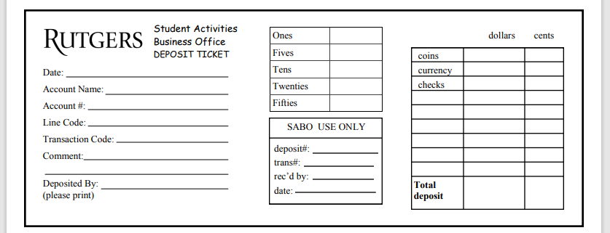
Deposit Slip:

Slide 40
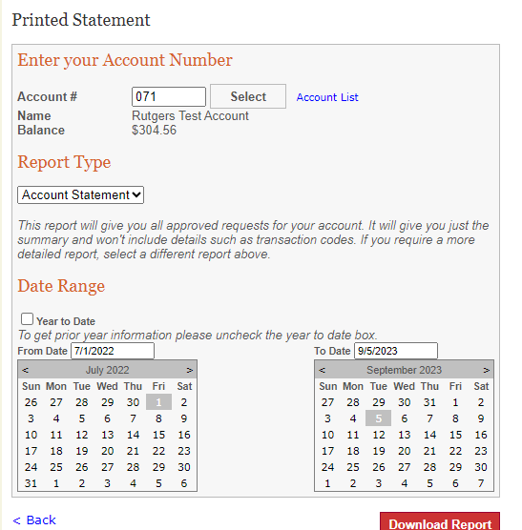
IMPORTANT - Review your Account Statement Regularly!
Click on “Statements” from the Dashboard
Enter the Account Number and select either “Account Statement” or “Request Details”.
Keep the “Year to Date” box checked or unclick it to choose a specific date range.
Click “Download Report” to generate a .pdf of your specified statement.
Note: Statements do not reflect pending transactions. Statements reflect only transactions that have been posted to the account.
Notes:
Review for COMPLETENESS: Make sure all your revenues (income) and expenses are reflected in your account. If missing, follow up!
Review for ACCURACY: Do you have pending transactions that have not been approved? Are you accounting for these expense amounts?
Deposits made at Student Centers
Keep your receipt
Follow up timely

Slide 41
Special Topics

Slide 42
CONSOLIDUS:
Rutgers Primary Licensee for Branded Merchandise is CONSOLIDUS https://www.swagbyconsolidus.com/
It’s the one-stop shop for all promotional and swag/giveaway needs.
All students can log in and browse using their Net ID.
Presidents and Treasurers have the authorization to place order. (discuss with Advisor prior to placing order)
All orders will be paid by invoice directly to Consolidus and will require the Treasurer to submit a check request to SABO. Ensure to also email the invoice with the “C” number in the subject line to SABO@echo.rutgers.edu.

Slide 43
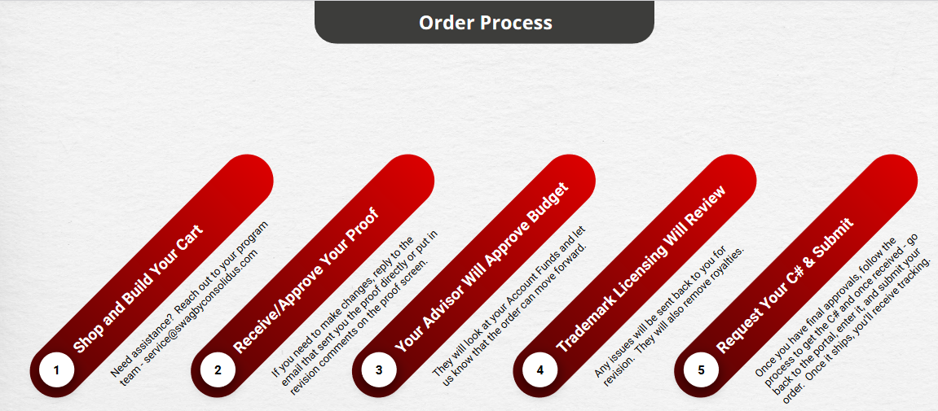
CONSOLIDUS WORKFLOW:
Notes:
Getting Started -> Quick Start Guide on swag.rutgers.edu
Can’t modify RU marking
Must use full org name
Need to be clear on “firm date”.
If ordering custom stoles – start the process in March in time for graduation.

Slide 44
TRAVEL:
No longer required to use DIRECT TRAVEL.
No home sharing (AirB&B, VRBO, etc.)
Conference Travel – student orgs must plan ahead so that we can pay hotel vendor via check instead of cash advance.
Required documents:
Booking confirmation
Proof of payment with a bank statement verifying the purchase
Hotel folio at check-out

Slide 45
Examples of Non-Reimbursable related to Travel:
Fees incurred for changing reservations (e.g. late check out fee, room upgrade)
Purchases using personal airline miles is not reimbursable.
Meals included in the cost of conference
Frequent flyer membership (e.g. air, hotel, preferred seating, “cancel any time” fees).
Notes:
*unless there is a business justification

Slide 46
Mileage Reimbursement
Mileage reimbursement covers the wear and tear of operating a personal vehicle for business reasons.
For 2024, the IRS mileage reimbursement rate is 67cents per mile driven for business use.
Business justification
Google Maps / round-trip
Normal commute must be deducted or not included.
Notes:
*mileage or gas receipt, cannot be both

Slide 47
Meal Limits/Group Meals:
Current meal reimbursement per person per day inclusive of tax and gratuity*.
$20 in-state
$30 out-of-state travel
Business Purpose of the Meal has to be stated
For Group Meals (sit-down meals): List NAMES OF ALL ATTENDEES on the back of the original, itemized* receipt.
Notes:
Unreasonably expensive meals will be capped. Gratuity for sit-down meals is limited to no more than 20% of meal total.
Advisor may change reimbursement amounts if request exceeds per day meal limit.
For now, these are the reimbursement limits.
*not the signature page of the receipt. Detail required.

Slide 48
Prize, Award and Gift Cards
All prize, gift cards must be purchased through generated revenue line code (137)
Include the name and/or netID of recipients for prizes under $60
Submit the Prize and Gift Form for prizes $60 or more, including SSN
Purchase made using a gift card, account credits (e.g. Amazon) is not reimbursable
Notes:
In-kind (gift basket), if worth $60 or more, need prize form

Slide 49
Specialty Catering/Panera
Approved list sent out monthly by OSI to Advisors
PANERA Catering Procedures
Student org contact Julio Urrutia (Catering Sales Manager) at least 1-2 weeks in advance at (732) 204-6395 or julio.urrutia@panerabread.com to place your order.
Inform Julio SABO Account Name and Number.
Julio will send student org an estimate so they can create a check request in SABO system.
Treasurer must send the estimate and C# to Advisor to review and approve/sign.
After Advisor signs the estimate, it must be returned to Julio.
Julio will send student org a final invoice to submit to SABO. Treasurer must write the C# on the invoice.
Notes:
Gerlanda’s, Szechuan Ichiban – PAY BY INVOICE, NOT OUT-OF-POCKET - you need to let them know that you are a student organization (provide account name and number). They will send you an invoice. You will need to create a check request and submit invoice to SABO with the C# written on it.
Specialty Catering for ethnic food vendors – OSI has a list updated monthly and distributed by Susan Romano, Associate Director. Check with your Administrative Advisor before ordering.

Slide 50
Other Items:
TIX.COM
Checklist through getINVOLVED
There are no refunds or exchanges.
Ticket sale revenue is booked monthly by SABO in the student org’s account
STUDENT CENTER MEETING SPACE AND RESERVATIONS INVOICING
Final invoices are sent to OSI.
OSI student worker enters the invoices and routes to Advisor for approval.
No need to send invoice with C# to SABO Email
END OF SEMESTER GIFTS
Student Organizations are prohibited from submitting reimbursement requests for gift expense to faculty and staff/advisors using SABO funds. This includes funds from Line Code 137/Misc. Generated Revenue.

Slide 51
Non-Reimbursable Expenses:
Although not a complete list, this list offers examples of expenses that will not be reimbursed by Rutgers University – Student Activities Business Office (SABO)
Fees incurred for changing reservations e.g. late check out fee, room upgrade, etc. (unless there is a business justification)
Unreasonably expensive meals, lodging. Gratuity is limited to 20%.
Any goods or services for student organizations purchased OUTSIDE of the United States (including contracting with an international vendor).
Purchases made using a gift card, account credits or using personal airline miles is not reimbursable
Branded merchandise, swag, promotional items not purchased through Consolidus.

Slide 52
Treasurer Responsibilities:
Plan, inform, ask before spending
Be organized, keep receipts
Communicate policies and procedures with fellow E-Board Members.
Be timely when submitting expenses for reimbursement
Utilize Administrative Advisor as your main point of contact
Familiarize yourselves with the various resources available
Notes:
Communication with your Advisor is KEY

Slide 53
SABO System Enhancements – IN PROGRESS
Ability to upload invoices in SABO System Ledger
Encumber funds before check request approval (pending status)
Clean-up of vendors in the SABO System Ledger

Slide 54
RESOURCES:
Training/Quiz* on CANVAS
sabo.rutgers.edu / Treasurer Information
Treasurer’s Key (handbook)
Consolidus Workflow
Tip Sheets
List of Non-Reimbursable Expenses
Forms
Deposit Slip
Prize, Award and Gift Card Information
Lost Receipt Certification
Consent to Reimburse
Fillable W-9
Notes:
After review of the Treasurer’s Key, PowerPoint on Treasurer Refresher Training, Tip Sheets, you are required to take the mandatory quiz. You will be given (3) tries and must score 80% or higher to pass. 25 questions (need 20 correct answers to pass).
Returning Treasurers who have taken the quiz in the past must re-take the quiz.

Slide 55
How to Access SABO Services?
In-person
Student Activities Center (SAC) – College Ave Campus
613 George St (Lower Level)
SABO Window Hours*: Monday-Friday 9am-4:30pm
Main Office: 848-932-6981
2. On-line (SABO System Ledger)
sabo.rutgers.edu
3. Email - Reference your SABO Account Name and Number, including the voucher C# in the subject line of your E-mail.
sabo@echo.rutgers.edu

Slide 56
Canvas – Treasurer Training
Notes:
After review of the Treasurer’s Key Handbook, Treasurer Training PowerPoint and Tip Sheets please take the mandatory quiz. You will be given three (3) tries and must have a score of 80 or higher to pass, which is equivalent to a score of 20 points out of 25.
Returning Treasurers who have taken the quiz in the past must re-take the quiz every year.
Due date: Friday, September 6, 2024 at 11:59PM

Slide 57
Weekly SABO Drop-In Office Hour via Zoom (or in person)
Mondays 9:30-10:30 am **beginning 9/9/24
Tuesdays 2-3 pm **beginning 9/24/24
Sign in to your Rutgers Zoom Account
Zoom Meeting ID: 538 538 3149
Zoom Meeting Password: 630856

Slide 58
Q&A
Thank you!

