Slide 1


Rutgers University
Student Activities Business Office
Treasurer Refresher
January 26, 2024
Website: http://sabo.rutgers.edu Email: sabo@echo.rutgers.edu

Slide 2
Today’s Session
SABO Office Staff, Location and Hours
Understanding our core responsibilities
Account Information
Allocations and Takebacks
SABO Online / Basic Navigation
Travel
Consolidus
Panera Catering/Meal Limits
Mileage Reimbursement
Non-reimbursable Expenses / Other Misc. Info
Treasurer’s Responsibilities and Resources
Notes:
SABO Online / Basic Navigation
Various type of check requests/transactions

Slide 3
SABO Office Staff
Charisse Gutierrez, Director/Business Manager
Geraldine Howard, Accounting Assistant I
Invoices | Contracts | Allocations/Takebacks
Jill Silverman, Accounting Assistant II
PERR | System Access | Canvas | List Serv
Gina DiMaria, Head Accounting Clerk
Rutgers Invoices (Dining, Facilities, Meeting Space & Reservations) | Donations | Cash Advances
Federal Work Study Students
Window/Answering Phones

Slide 4
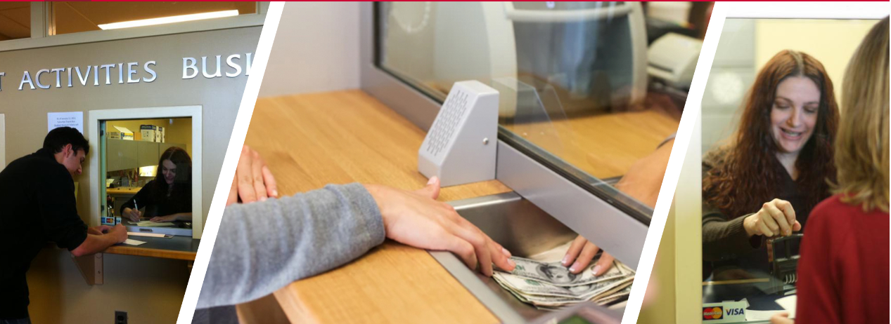
SABO Location & Hours
We are located on the Lower Level of the Student Activities Center on the College Avenue Campus.
613 George St.
During fall & spring semesters we are open Monday-Friday, 8:30AM-5PM
Window hours Monday-Friday is from 9 to 4:30 PM
Notes:
If you Email us after 5pm or on the weekend, we will not respond until the next business day.

Slide 5
Our Core Responsibilities
We administer and manage the financial resources of the undergraduate student governments, student organizations and other similar student-driven organizations of Rutgers university.
We manage the student organization funds, which is comprised of student fees, generated revenue, dues and allocated funds.
We provide the administrative infrastructure (ledger system) for students (E-board members: treasurer/president & advisor) to account for the financial transactions of their organization.
We ensure compliance with university policies & procedures in relation to the use of student and university funds.
Notes:
SABO’s core function is accounts payable (A/P) & student expense reimbursements. Faculty and staff cannot be reimbursed from SABO student org account.
We do not do advising. Instead, we partner with OSI Administrative Advisors. Your Advisors must be your first point of contact!

Slide 6
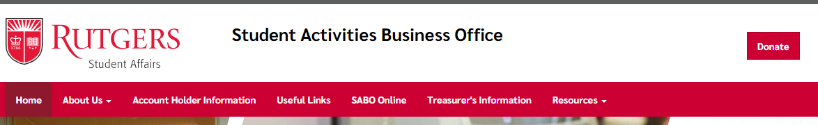
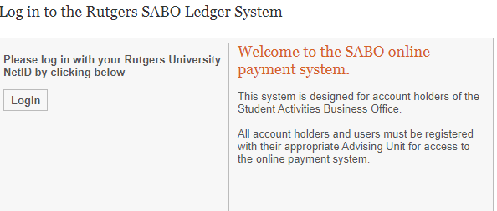
SABO Online
To enter the SABO Online system, click the “SABO Online” link from our website.
To log in to SABO Online use your Rutgers NetID. You must be a registered user to enter the system. Contact your advising area for further information.
Notes:
At this time, all new registered Treasurers* for 2023-2024 should have access to the SABO System Ledger On-line. However, no transactions can be entered until you’ve completed the mandatory Treasurer’s Training (RUSA, RBGA, SEBS organizations only). Presidents now have READ ONLY access.
Please try and access the system using your phones: sabo.Rutgers.edu
If you cannot log in, please Email SABO@echo.Rutgers.edu [Reference your Account Name and #].
If there was a change in officer since your initial registration, did you complete a Change of Officer form and submit to OSI? OSI informs SABO. SABO makes the change.

Slide 7
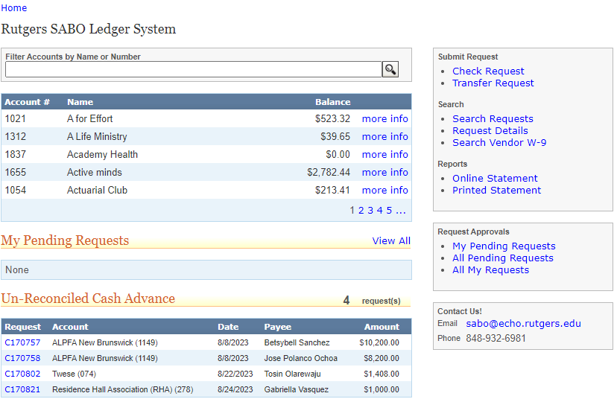
SABO Online Dashboard
Your Dashboard displays:
  Account Balances
And has links to:
  Start a Check request
  Start a Transfer
  Generate your Account Statement
  Search Requests
Notes:
From your dashboard, you can see all accounts that you have access to, have the ability to submit requests, be able to search transactions as well as view your statement on-line or print. You can also view your pending/all requests submitted.

Slide 8
Account Information
Each account at the SABO has an Account Number, usually 3 or 4 numbers used to differentiate your account (e.g. 063 | Bengali Student Association).
Most accounts will have multiple Line Codes or subaccounts used to isolate the source or intended use of funds (e.g. 137 Generated Revenue for account 063, noted as 063/137).
Most transactions will also require you to select a Transaction Code that identifies what money is being spent on. (e.g. noted as 063/137/225 when account 063 uses Generated Revenue (Line 137) to pay for supplies or decorations (Transaction Code 225).

Slide 9
Account Information (cont’d)
All accounts at SABO have two Account Users. The Account Treasurer will have REGULAR access. This access will allow them to create transactions within SABO system ledger. The Account President will have READ ONLY access. This access will allow them to view transactions.
All accounts at SABO have a Control Account and an Administrative Advisor assigned. The Control Account indicates which governing area oversees your account and your Administrative Advisor will be a representative who must authorize your account transactions.
Notes:
We observed many instances where a student is a Treasurer in one organization and President in another. We can only enter 1 role in the system so they will be coded as TREASURER for both.

Slide 10
Allocations and Takebacks
All SPRING Allocations received by SABO from RUSA, SEBS and RBGA have been processed into your respective accounts.
Allocation funds are entered in your Overhead (317) and/or Program (345) Line Codes and in some cases, Special Allocation line code (700).
At the end of each semester, any unspent funds and 345 are “taken back” (returned to the respective Control Account). At the end of the AY, any unspent funds in 317 are taken back.
Takebacks are used to fund appeals for the following semester.
It is important that expenses are submitted within 30 days of incurring the expenses and that transactions posted in your account are reviewed for completeness and accuracy.
Notes:
If you think your allocation amount is incorrect or has not been entered in your SABO account, please check with your Advising area or Governing Council.

Slide 11
A check request can be for:
When initiating a Check Request in the SABO Online System, it is important to be able to answer the following questions:
  Who are you paying?
    Is this check to pay a person? (PERR, Contract)
      Did someone in your organization spend their own money? A PERR is a reimbursement check request to repay someone who spent personal money on approved items.
    Is this check to Rutgers vendors or a Rutgers department?
    Is this check to pay an outside vendor (By Contract or By Invoice)
    Is this check a donation?
Notes:
Know who you are paying, Know what you are requesting

Slide 12
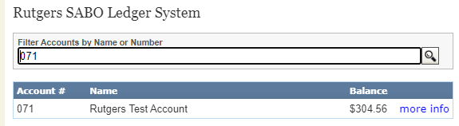
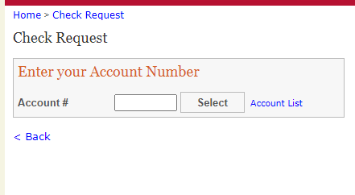
After you review the dashboard information and know your account balance you may begin to process a check request.
Click check request on the right hand side of the dashboard page and enter your account number
Notes:
Please enter your account number in the space provided.

Slide 13
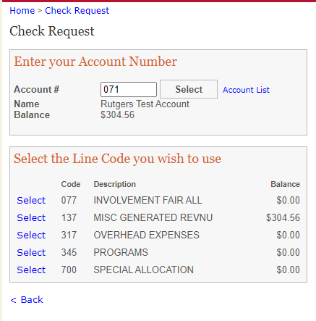
Check Request Transactions
After you have chosen the check request option on the dashboard and entered your account number and line code you will be asked:
Who or what you are paying for?
Depending on your answer the next few slides will guide you through the check request process.
Notes:
There are questions for you to answer to guide you through the request process. Depending on who you are paying will determine the type of transaction to do.

Slide 14
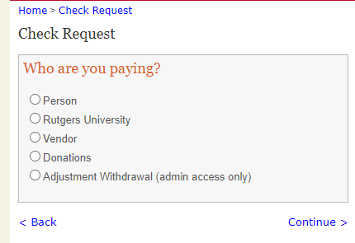
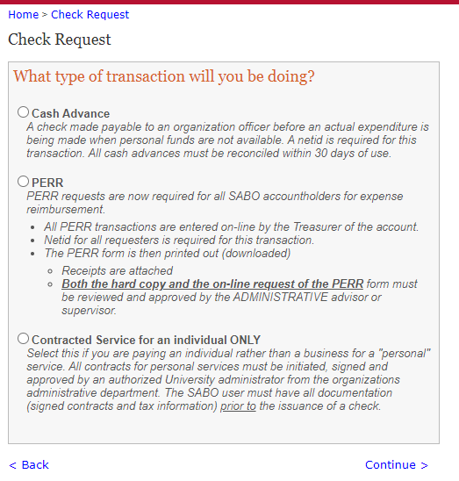
Most common Check Request is to pay a person
Cash Advance
PERR
Contracted Individual
Notes:
There are three ways a person can be paid . Cash Advance, PERR personal expense reimbursement and Contracted Individual.

Slide 15
Cash Advances
A NET ID is required for all Cash Advances and are available any time funds are needed prior to an expenditure being made or whenever personal funds are not available.
Requests Cash Advance at least 2 weeks before you need the funds.
Any cash advance must be supported by a budget.
After the funds have been used, original/itemized receipts and the reconciliation form must be submitted to the SABO. Download your Reconciliation form and present to SABO within 30 days of when the Cash Advance was issued (check date), not when it was spent. Any delinquent Cash Advances in excess of 60 days will be grounds for suspension of all account activity.
Notes:
There are 2 types of cash advances (1) related to your event (2) Travel – when your org is going away on a conference, trip or event.
3 Steps: (1) Request the Advance (2) Cash and spend the funds (3) Reconcile the advance.
In the past, we’ve had students submit receipts significantly above the original amount. This year, we are capping that to no more than 10% of original amount. So budgeting/estimating on the part of the student organization is important. The student has the option to submit a PERR form for expenses outside their original budget.
To illustrate: Cash Advance amount $100 x 10% = $10. You cannot submit receipts over $110.

Slide 16
Cash Advances (cont’d)
The person who is the Payee in a cash advance check is the person responsible for reconciling the cash advance.
All Cash Advance requests for travel must include booking confirmation.
Proof of payment is required for all Cash Advance expenditures over $500.
SABO will not approve new Cash Advances if student organization has any delinquent Cash Advance over 60 days.
Only 2 cash advances can be outstanding at any given time.
Notes:
Reconciliations are not seen by the Advisor. Only SABO sees and compares it to what was budgeted. If anything doesn’t look reasonable, we will always reach out to Treasurer/Advisor.

Slide 17
PERR Form
All PERR forms must be submitted with original, itemized receipts (no pictures, no copies, no screenshots), within 30 days of incurring the expense. Treasurers must submit to Advisor -> Advisor reviews/signs-off and submits to SABO.
All receipts submitted for reimbursement should be marked paid or have a zero balance. Submitted reimbursements for an individual item over $500 require proof of payment. Payment status should be “Posted” and not “Processing”.
Proof of Payment means a credit card or bank statement to verify the purchase. If proof of payment is under a parent/guardian name, a completed Parental Consent to Reimburse Form must accompany the PERR form. Payee and information on proof of payment must match.
If a receipt is lost, a Lost Receipt form is required. Please ensure this is signed by both the person being reimbursed and the Advisor.
Notes:
PERR Personal Expense Reimbursement Report. Show example of Amazon receipt and proof of payment (credit card transaction).
I use an App called “ADOBE SCAN”. You can scan using App and convert it to PDF which you can then Email it to your Advisor/SABO from your phone.

Slide 18
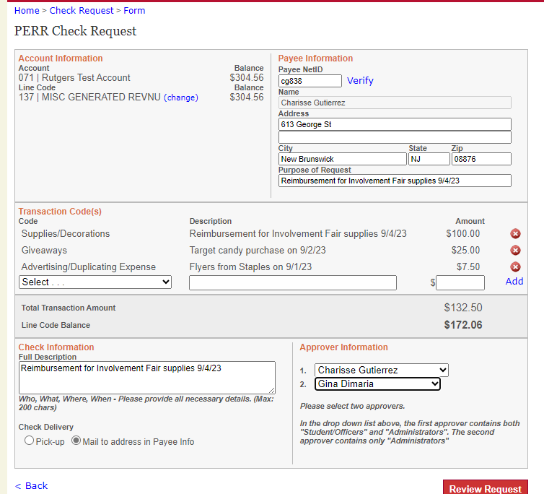
Notes:
PERR form review. Once reviewed hit submit.

Slide 19
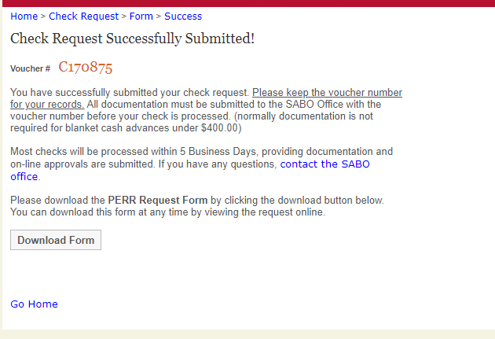
Notes:
Take note of the Voucher# or C#

Slide 20
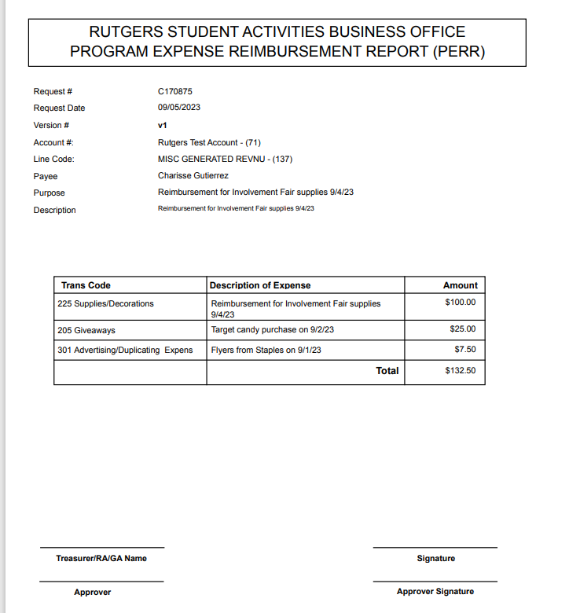
Notes:
PERR form review. Once reviewed hit submit.

Slide 21
Contract/Service Agreement
A contract transaction is a legal agreement between the vendor/supplier for services rendered to your student organization.
Examples: non-Rutgers catering, off-campus banquets/retreats, performers (paid or unpaid), non-Rutgers equipment rental, DJ services, photography services.
All organizations must meet with an Advisor for approval before moving forward in planning an event.
Request that the individual/company you intend to transact with completes a W-9.
All contracts must be prepared and approved through a contract checklist (getINVOLVED site) submitted to Office of Student Involvement (OSI).
OSI will review the contract checklist information and prepare a contract. The contract is then sent out for signatures.
At this time, a check request may be entered in the SABO system and approved by an Advisor.
The executed (signed) contract and current W-9 form is forwarded to SABO.
SABO will process for payment.
Notes:
Another type of PERSON payment is a CONTRACT.
Ensure that the information entered in the contract checklist matches the information on the W-9.

Slide 22
Contract/Service Agreement Tips
Student organization members should NEVER sign contracts on behalf of the organization.
Never pay an outside party out of pocket.
Plan ahead – in order for your Advisor and SABO to complete the processing of the information, it is recommended that you begin this process 2-3 weeks before your event.
Is person an Employee of Rutgers? Must complete the bottom of page 3 of the contract it its entirety:
  “I am currently a Type# _____ employee of Rutgers University, in the __________department. My location code is ___________, My payroll contact is ____________ and their E-mail address is _____________.
SABO Staff to enter Transfer from student org account to #820 Administrative Reimbursement Clearing. SABO Business Manager to contact employee’s supervisor to initiate contract payment via Payroll.
Notes:
We cannot pay a Rutgers employee through SABO. It must go through Payroll.

Slide 23
Not paying a person?
There may be times your organization will not be paying a person.
The following slides include detailed instructions on how to pay :
  Rutgers University
  Vendor
  Donations

Slide 24
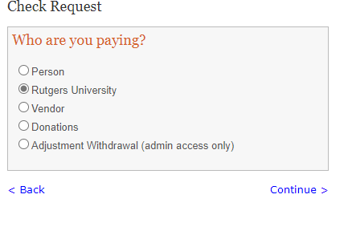
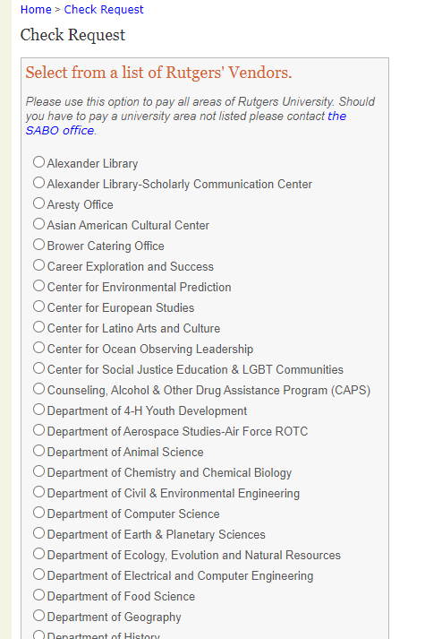

Slide 25
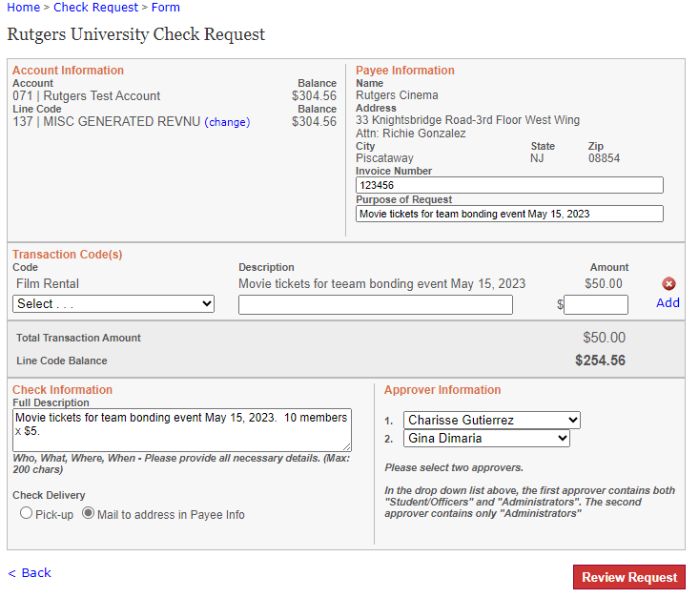
Notes:
All vendors, including Rutgers vendors, must be filled in completely. Also on invoices you receive from a vendor, an invoice number must be indicated. Always put in the purpose of request. Then the transaction description which describes the expense. And finally full description. Make sure the Payee information matches information on the Invoice.

Slide 26
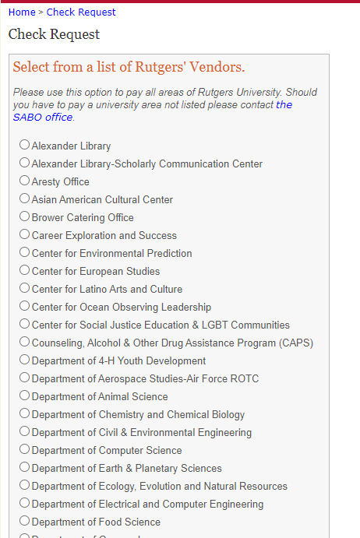
Check Request – Rutgers
Don’t see the Rutgers Dept. you need to pay OR unsure of the correct RU Dept.? Email us and we can add them or clarify!
Pick out the RUTGERS VENDOR you wish to pay.

Slide 27
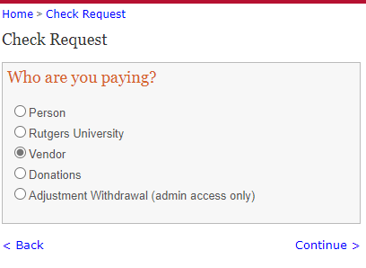
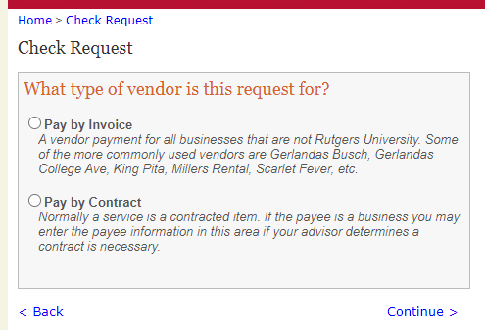
Check Request – Vendor
If there was a contract signed, Pay by Contract
If no contract was signed and you have an invoice from a vendor, Pay by Invoice.

Slide 28
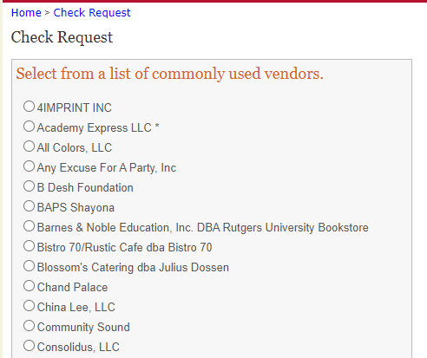
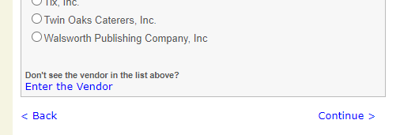
If you Pay by Invoice, SABO Online will bring up a list of Commonly Used Vendors. Review the list – if you are paying one of these vendors, select them on the left. If not, click “Enter the Vendor” at the bottom of the screen to enter the information manually.
Notes:
We do not pay on Quotes or Estimates (except for Consolidus and Panera). Please ensure vendor has issued a final Invoice.
Our list of commonly Used Vendors does not mean that they are an approved vendor for you to use. Example: Krispy Pizza

Slide 29
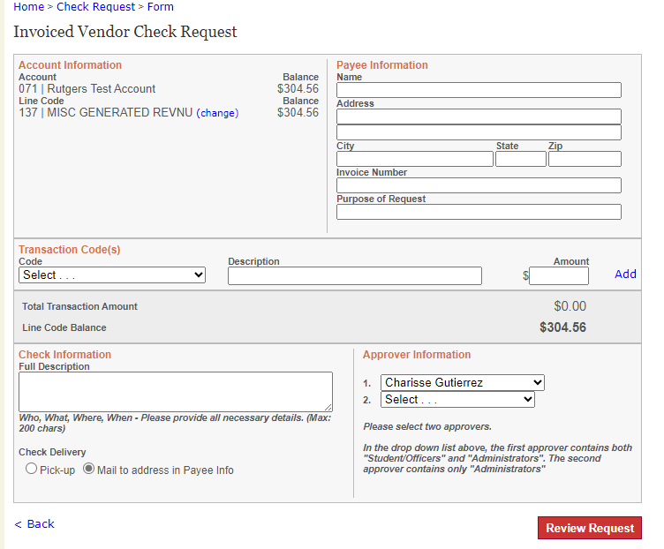

Slide 30
What Happens After I Submit a Check Request for a non-person (Contract, Invoice, Donation)?
Write down the Voucher # or “C” # (check request) on your supporting documentation.
E-mail your Advisor that a request has been submitted and requires approval.
All documentation with the “C” number must be submitted to your Advisor for review.
After review, your Advisor will submit to SABO.
Once the request is approved and appropriate documentation is received by SABO, checks request will be processed.
A check will be printed and sent out based on Check Delivery selection: “Pick-up” or “Mail to address in Payee info”

Slide 31
Donations
Student organizations may make donations from their Misc. Generated Revenue line code (137) only.
All donations must be made to an approved charity that has 501©(3) status recognized by the IRS.
Address needs to match the charity.
The charity must be in the United States.
No documentation is needed as long as there is a valid Federal Tax ID number and is found in the IRS website
SABO will approve when it is a verified 501©(3)
SABO will mail check requesting a receipt/acknowledgment for the donation

Slide 32
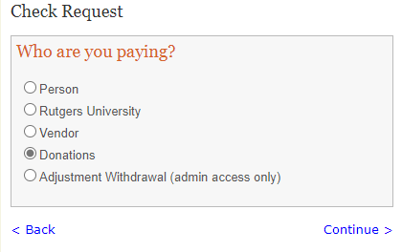
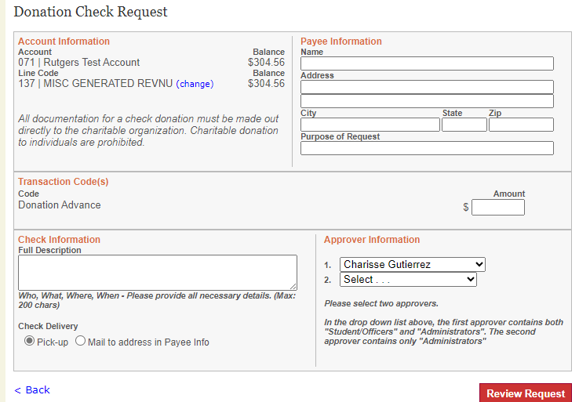
Donations

Slide 33
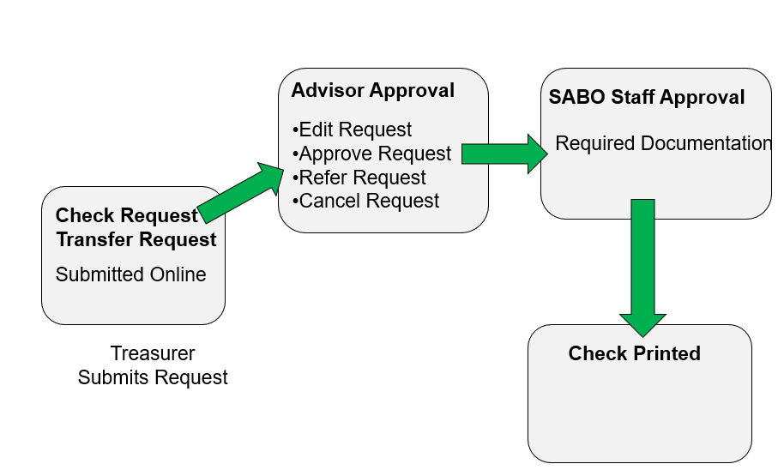
Submission Flow Chart
Notes:
If check is more than $10,000, additional approval by the Assistant Vice Chancellor of Finance and Administration is needed prior to release of check.

Slide 34
Status of Check Request
Pending – waiting on Advisor approval
Submitted to SABO for Approval – if it has been more than a week, please contact SABO. This may mean we have not received supporting documentation to complete processing
Approved – supporting documentation was reviewed and request is approved for payment. This is when funds are encumbered from your account.
Check Cut – check is printed and will be mailed or check is available for pick up (within 3 days of the check date)
Notes:
Just remember again that PENDING/SUBMITTED TO SABO FOR APPROVAL transaction amounts have not been subtracted from your account balance! Only after it has been APPROVED by SABO will your account balance reflect correctly.

Slide 35
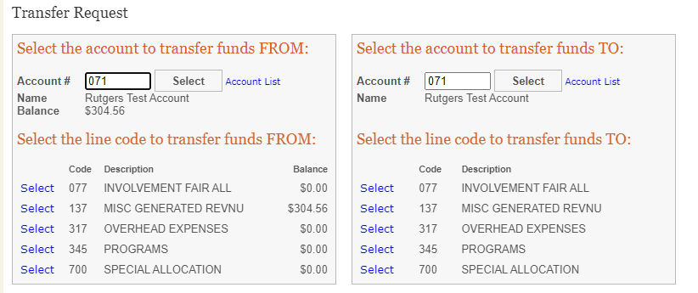
Transfers
Select Transfer Request from the Dashboard.
Enter “from” account and select the Line Code and “to” account and select the Line Code.
Choose Transaction Codes and provide a full description for the transfer, choose the approvers, and enter the exact amount.
Review your request, submit if correct, and write down the Transfer Number.
Notes:
To illustrate:
If you do not have enough funds in your O/H or Program lines, but you do in Misc. G/R, you can transfer out however, you cannot transfer from 317/345 to 137.

Slide 36
Depositing into your SABO Account
A Deposit Slip must be completed for the funds to be properly credited to your SABO Account.
Include on each check: Account number, Line Code, and Transaction Code (e.g. “123 | 137 | 061”)
All checks must be made out to “Rutgers University”.
You will receive a receipt after the deposit is made.
All funds deposited will be credited after 5pm.
Any returned checks will be debited (subtracted) from your account. It is the responsibility of the Treasurer to pursue collection.
Checks that are DONATIONS cannot be deposited directly to your SABO account. Please see Business Manager who will route it to the Foundation for processing.
Notes:
Donation receipts must flow through the RU Foundation. It will ultimately get deposited to your SABO account.

Slide 37
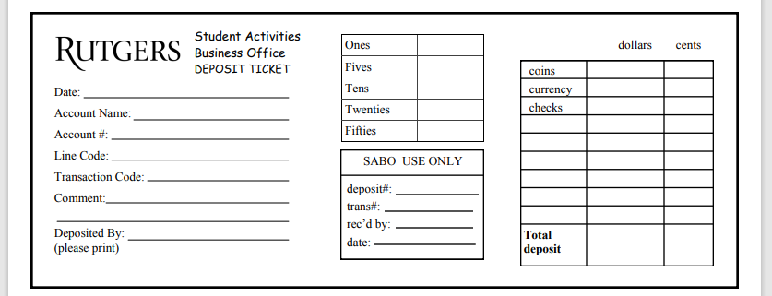
Depositing into your SABO Account

Slide 38
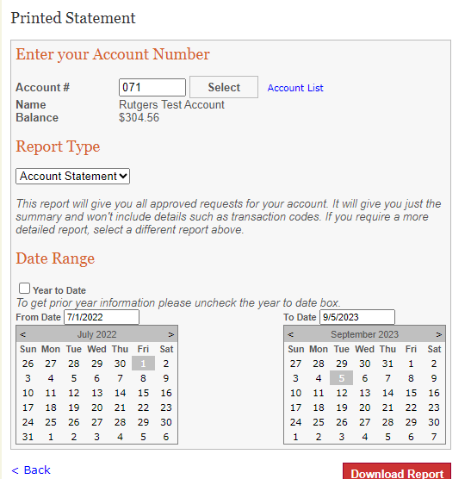
IMPORTANT - Review your Account Statement Regularly!
Click on “Statements” from the Dashboard
Enter the Account Number and select either “Account Statement” or “Request Details”.
Keep the “Year to Date” box checked or unclick it to choose a specific date range.
Click “Download Report” to generate a .pdf of your specified statement.
Note: Statements do not reflect pending transactions. Statements reflect only transactions that have been posted to the account.
Notes:
Review for COMPLETENESS: Make sure all your revenues (income) and expenses are reflected in your account. If missing, follow up!
Review for ACCURACY: Do you have pending transactions that have not been approved? Are you accounting for these expense amounts?

Slide 39
Booking Approved Travel
All Rutgers-related travel can be booked via travel website of your own choosing.
Include booking confirmation (air, hotel, rail) received.
You must also provide proof of payment with a credit card or bank statement verifying the purchase if more than $500.
IMPORTANT: Student organizations are not permitted to book Airbnb/VRBO/Home-Sharing, for any reason, for Rutgers-related travel.
Notes:
There are still a many student organizations who are booking air using other non Rutgers travel booking sites like Hopper, United Airlines, Kayak, etc.
TRAVEL FUNDING/EXPENSES
Remember to discuss with your Advisor payment options for lodging, transportation and food before booking.
Airbnb/VRBO/Home-Sharing
Rutgers’ duty of care obligations extend to ensuring the safety and security of all student residences, including student travel residences. Rutgers cannot uphold those obligations with Airbnb, VRBO or other home-share providers. Therefore, effective immediately, student organizations are not permitted to book this type of accommodation, for any reason, for Rutgers-related travel.
If your trip is funded by student fees, it is Rutgers-related travel.

Slide 40
Consolidus – Rutgers Swag
Rutgers Primary Licensee for Branded Merchandise is CONSOLIDUS, LLC. https://www.swagbyconsolidus.com/
It’s the one-stop shop for all promotional and swag/giveaway needs.
All students can log on and browse using their Net ID.
Presidents and Treasurers of each organization have the authorization to place order.
All orders will be paid by invoice directly to Consolidus and will require the Treasurer to submit a check request to SABO. Ensure to also email the invoice with the “C” number in the subject line to SABO@echo.Rutgers.edu.
Notes:
CUSTOM INK, JERSEY FRESH, SCARLET FEVER are not approved Rutgers vendors. Rutgers Primary Licensee for Branded Merchandise is CONSOLIDUS, LLC. https://www.swagbyconsolidus.com/
Lindsey Myers, Senior Program Director | Key Accounts, Rutgers
swag.rutgers.edu
A step by step workflow is available on our website and/or the swag portal.

Slide 41
Panera Catering
Procedures
Student org contacts Natalie Kovacs at least 1-2 weeks in advance at (732) 204-6395 or natalie.kovacs@panerabread.com to place your order.
Natalie will send org an estimate so they can create a check request in SABO.
Treasurer must send the estimate with C# to Advisor to review and approve/sign.
After Advisor signs the estimate, it must returned to Natalie.
Natalie will then send student org a final invoice to submit to SABO. Treasurer must write the C# on the invoice.
Notes:
Gerlanda’s, Szechuan Ichiban – PAY BY INVOICE, NOT OUT-OF-POCKET - you need to let them know that you are a student organization (provide account name and number). They will send you an invoice. You will need to create a check request and submit invoice to SABO with the C# written on it.
Specialty Catering for ethnic food vendors – OSI has a list updated monthly and distributed by Susan Romano, Associate Director. Check with your Administrative Advisor before ordering.

Slide 42
Meal Limits
Current meal reimbursement per person per day inclusive of tax and gratuity.
$20 in-state
$30 out-of-state travel
Business Purpose of the Meal has to be stated
For Group Meals (sit-down meals): List NAMES OF ALL ATTENDEES on the back of the original, itemized* receipt.
Notes:
For now, these are the reimbursement limits.
*not the signature page of the receipt. Detail required.

Slide 43
Mileage Reimbursement
Mileage reimbursement covers the numerous costs (wear & tear) of operating a personal vehicle for business reasons.
For 2024, the IRS mileage reimbursement rate is 67 cents per mile driven for business use.
Business justification
Documentation: Google Maps / round-trip

Slide 44
Prizes (Gift card or in-Kind and Awards)
All prize, gift cards must be purchased through your generated revenue line of your organizations account.
Did you include the name of recipients & net ID for prizes under $60?
Did you submit the Prize, Award and Gift Card Information Form for prizes $60 or more, including SSN?
Notes:
Gift baskets follow the same. If worth $60 or more, need Prize Form.

Slide 45
Non-Reimbursable Expenses
Although not complete, this list offers examples of expenses that will not be reimbursed by Rutgers University – Student Activities Business Office (SABO)
Fees incurred for changing reservations (e.g. late check out, preferred seating) (unless there is a business justification)
Unreasonably expensive meals and lodging. Gratuity for sit-down meals is limited to no more than 20% of meal total.
Paying for an expense using VENMO (or any other non-cash app like Zelle/CashApp) to a person/entity
Any goods or services for student organizations purchased OUTSIDE of the United States
Expenses that are not Rutgers student organization/club related
Meals included in the cost of conference/meeting fees/meets
Purchases made using a gift card, account credits (Amazon) or using personal airline miles
Alcoholic beverages
SWAG purchases not through Consolidus.

Slide 46
Miscellaneous Info
TIX.COM
Checklist through getInvolved – include SABO account name and number; EVENT Name should be separate
There are no refunds or exchanges
Revenues from ticket sales are booked to student org account monthly
STUDENT CENTER MEETING SPACE AND RESERVATIONS INVOICING
Final invoices are sent to OSI. OSI student worker enters the invoices and routes to Advisor for approval.
No need to send invoice with C# to SABO Email
END OF SEMESTER GIFTS
Student Organizations are prohibited from submitting reimbursement requests for gift expense to faculty and staff/advisors using SABO funds. This includes funds from Line Code 137/Misc. Generated Revenue.

Slide 47
System Enhancements in Progress
Clean-up of vendors in the SABO System Ledger – on target for 2/29/24
Ability to upload invoices/receipts in SABO System Ledger – on target for 3/31/24
3. Encumber funds before check request approval (pending status) – on target for 6/30/24.

Slide 48
Review Treasurer Responsibilities
Plan, inform, ask before spending
Be organized, keep receipts
Communicate policies and procedures with fellow E-Board Members.
Be timely when submitting expenses for reimbursement
Utilize Administrative Advisor as your main point of contact
Familiarize yourselves with the various resources available

Slide 49
Resources
  Weekly Drop in Hour with SABO Business Manager (via Zoom or in-person on Tuesdays)
  Treasurers’ Key Handbook
  Tip Sheets for common transactions
  Forms
  CANVAS Treasurer Training Mandatory quiz for all Treasurers
  Weekly Treasurer List Serv (distribution on Thursdays)
Notes:
We are here to support you! Please familiarize yourself with the many resources we offer for support.
For the ListServ – pay attention to this Email. We compile some of the issues we observed during the past week and clarify the policy and procedures.

Slide 50

Weekly Drop-In
Beginning, Tuesday, September 5, 2023, Drop-In SABO’s Business Manager’s Zoom Personal Meeting Room from 1:30 to 2:30 PM to Ask Questions….
(Weekly on Tuesdays!)
Details:
Sign-in to your Rutgers Zoom Account
Meeting ID: 538 538 3149
Password: 630856

Slide 51
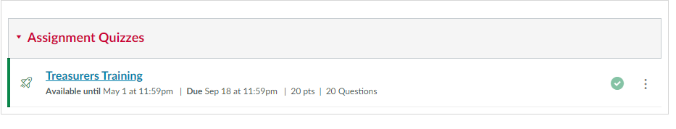
Canvas – Treasurer Training
Notes:
After review of the Treasurer’s Key Handbook, Treasurer Training PowerPoint and Tip Sheets please take the mandatory quiz. You will be given three (3) tries and must have a score of 80 or higher to pass, which is equivalent to a score of 16 points out of 20 or greater.
Returning Treasurers who have taken the quiz in the past must re-take the quiz every year.

Slide 52
Questions? Just Ask!
@
Email: sabo@echo.rutgers.edu
Phone: 848-932-6981
Location: Student Activities Center – Lower Level College Avenue Campus
613 George Street
Notes:
Reference your SABO Account Name and Number, including the voucher C# in the subject line of your E-mail.

